Slide 1


National Healthcare Language Program
Carolyn Duvar
Rebecca Martin-Fraser
June 2025

Slide 2
Agenda
  Introduction to the National Healthcare Language Program
  Innovative redesign based on need
  Implementation

Slide 4





Introduction- Partners
Nova Scotia, Prince Edward Island, New Brunswick, Newfoundland and Labrador
Ontario
Alberta, Saskatchewan, Manitoba
British Columbia, Yukon, Northwest Territories, Nunavut
Funder
Notes:
The national healthcare language program is funded by IRCC and therefore free for eligible participants across Canada. Our partners in Ontario are the Catholic Centre for Immigrants and World Skills Employment Centre; in the prairies, Calgary Catholic Immigration Services; and in BC, ISSofBC’s Language and Career College. ISANS works with IEHPs in Atlantic Canada. All of our partners have expertise in the area of workplace communications and contacts and connections within their regions. Between us we cover all of Canada, except Quebec.

Slide 5
ISANS Healthcare Courses Timeline
2005 Provincial In-person Days
2017 Provincial Blended Learning Days
2020 Provincial Online Days
2024 National Program
2025 Incorporating AI
Notes:
We'd like to begin with a brief description of our program, its aims and structure.
1. So, the original course was offered in person using a textbook developed in-house by EAL curriculum developers and was reviewed by healthcare professionals to ensure authenticity. In addition to in-person courses, there were regular site visits.
2. 2017 - IEHPs expressed that they needed more flexibility, so our first major transformation was adapting to blended learning:
•Created an online version of the course content and combined it with one 3-hr in-person evening class/wk
•Online work and assignments were submitted through the new online platform
Our Language Services Manager had an eye to the future with possibility of going national, which informed our approach. We had another program SOPA that had gone national and was doing well.
3. in 2019 we decided to redesigned the course into 2 profession specific exam prep courses due to the students requests for help with their high stakes licensure exams. It was ready to pilot in early 2020 so we were more easily able to pivot to 100% online with the emergence of covid as a global pandemic.
4. 2023
•IRCC asked us to go national with our healthcare courses (in the Spring of 2023)
•ISANS drafted a proposal, which was approved in Nov 2023, and we officially started nationally in March 2024.
This enabled us to go national! The course design was ready and we were able to establish several partners across the country.

Slide 6

Introduction - Clients
Internationally educated healthcare professionals
Physicians
Pharmacists
Nurses
Notes:
Our national project is funded to support international medical graduates, international pharmacy graduates and internationally educated nurses. Most are working towards becoming licensed to work in Canada. It is a long, difficult and expensive process.

Slide 7
Introduction - Purpose
Improve healthcare professionals’ communication skills
1
Empower healthcare professionals to thrive in Canadian working environment
2
Bridge the possible cultural gap
3
Prepare healthcare professionals for certain exams
4
Notes:
The purpose of our courses is mostly different aspects of communication required for their professions in the Canadian healthcare system.
So while we help them prepare for the tests, we try to identify possible cultural gaps and address them so that healthcare professionals can communicate more effectively and thrive in their new working environment.

Slide 8
Introduction - Courses
CSPI (Communication Strategies for Patient Interactions)
To improve communication skills for OSCEs Focus on patient communication
8 weeks
Synchronous online sessions + Asynchronous activities
Strategies for CELBAN
To prepare nurses for CELBAN To prepare nurses for work in Canadian context
52 weeks
Asynchronous
PCSN (Professional Communication skills for Nurses)
To empower nurses to communicate effectively with patients in a Canadian healthcare context
8 weeks
Asynchronous
Notes:
The courses that we offer right now are these 3.
CSPI prepares the students for communication skills they need in OSCEs which stands for Objective Structured Clinical Examination. This is one of the required exams during the licensure process of doctors, pharmacists and dentists – (we are funded for dentist only in NS).
English Language Benchmark Assessment for Nurses. It is one of the approved language proficiency tests for nurses. The 52 weeks is for all four skills but modules can be taken simultaneously so it reduces the time.
The latest development for this course is that the physicians and pharmacists are now requesting to take modules to help them improve their skills further or to prepare for other language proficiency exams such as the OET.
PCSN is workplace focused for IENs and was a response to IENs requests/needs for a shorter communication course.

Slide 9
Simulation Implementation
In-person simulated patients
AI
virtual patients
Online simulated patients
Notes:
When we redesigned some of our healthcare communication courses to be exam focused, the research told us…
Authentic simulated exam practice is critical.
It needs to be set up the same as the exam and give the clients feedback in terms of their readiness for their exams.
For example, in our Strategies for CELBAN course we worked with Touchstone Institute to create an online practice exam to simulate the CELBAN language proficiency exam.
For our OSCE prep course we needed to simulate the process they will go through to do the exam.
This led us to Healthcare simulations
We have added 3 types of simulation into our NHLP courses to help the students practice their skills.
In-person simulated patients
Online simulated patients
AI virtual patients

Slide 10
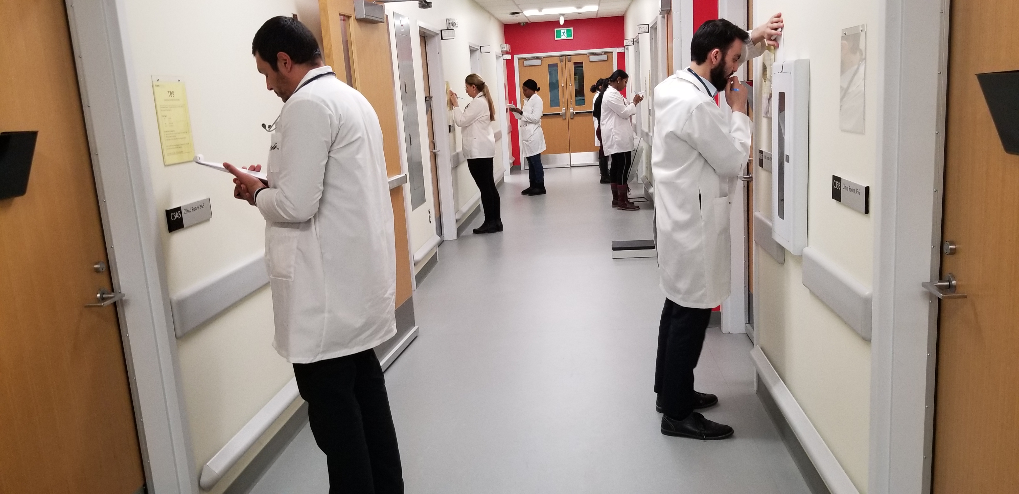
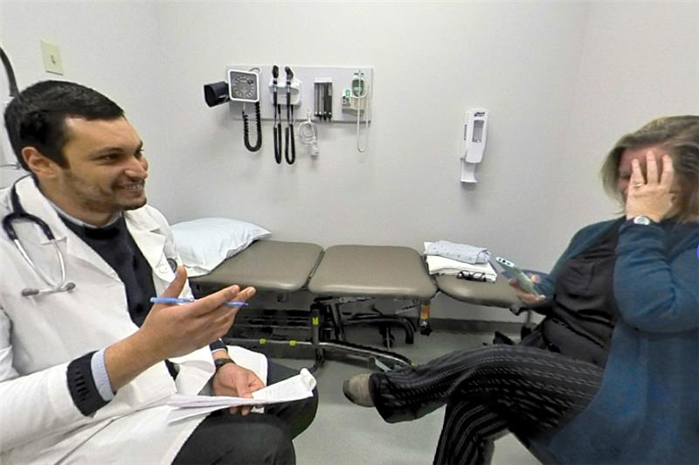
In-person simulated patients
Worked with Dalhousie - Centre for Collaborative Clinical Learning and Research
Authentic exam environment
Simulated Patients
Notes:
We reached out to Dalhousie C3LR – Center for Collaborative Clinical Learning and Research
Works with medical school and health professions
They have run OSCEs onsite (explain hallway picture)
Dal professionally trained simulated patients – some are actually actors (explain OSCE station picture)
They helped us develop our Communication Practice session
Design to our objectives
Helped us write cases for our students to practice the communication skills learned in the course
Recruit and train SPs
Pre-brief
Run session – we watch on monitors
Debrief
Record interactions and send to students

Slide 11
Why?
  National Program – 100% online
  Need to add simulations online
How?
  University of Toronto & University of Calgary
  Sessions via Teams
Benefits
  Accessible nationwide
  Cost effective
Challenges
  Technology issues
  More staff needed on our end
  Body language element
  Debrief dynamic is different than in-person
Online simulated patients

Slide 12
AI
virtual patients
Incorporated AI
Addressed challenges of asynchronous simulation need
Challenge:
Replacing in-class role-plays and practice
Solution:
Using AI avatars for role-play practice and assignments
Notes:
We incorporated AI to make our courses more accessible and inclusive.
1. Due to distance, time and scalability we had to bring back the missing ‘in-person’ aspects of the program.
2. In addition to adapting our simulation sessions to an online format, our second challenge was that nurses were not able to meet the attendance requirement due to shift work schedules, etc.
3. The decision was made to redesign all the nursing courses to be asynchronous so they could do the work at any time.
4. As a non-profit we had a lot of restrictions. Most companies were too expensive, but we eventually found a Canadian company called CyberPatient that believed in our mission, to help internationally educated healthcare professionals in their licensure process, so we partnered with them.

Slide 13
CyberPatient Partnership
CyberPatient
innovative virtual hospital platform
over 130 interactive patient cases allows students to apply their theoretical knowledge in a realistic, safe, and on-demand virtual environment
future healthcare professionals can build confidence and competence before stepping into real-world practice.
Notes:
CyberPatient is a virtual teaching hospital with over 130 diverse patients, helping students build real-world clinical skills through guided and self-directed case-based learning. It offers a safe space to move from theory to practice, developing clinical reasoning and communication skills.
While the platform covers the full spectrum of patient care, including the clinical aspects, one key feature we’ve been using in our programs through CyberPatient is history taking.

Slide 14
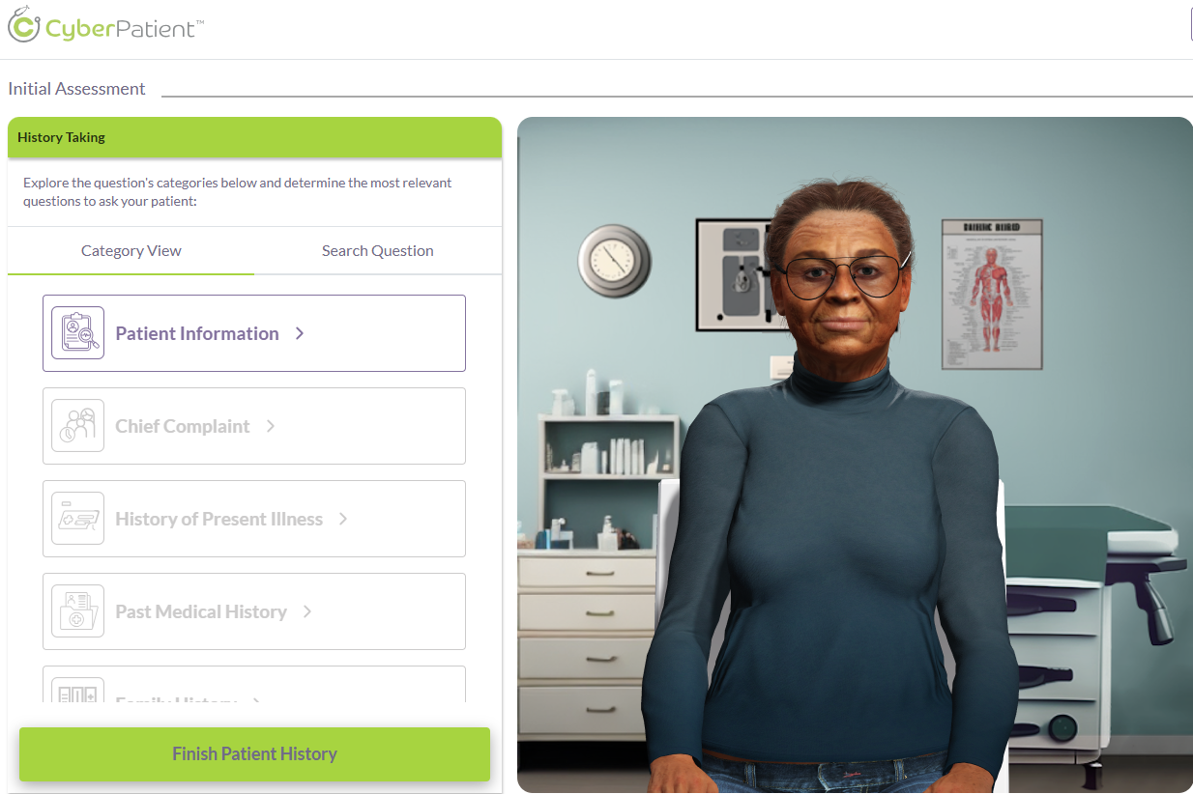
CyberPatient – Structured History Taking
Notes:
•With the first virtual patients that students will work with, the system prompts the student to select appropriate questions, in a structured format to gather information about their complaint.
•This structured approach reinforces their theoretical knowledge while helping them develop the skills needed to navigate real clinical encounters. We use this to scaffold into the free form version as practice activities before assignments.
•Although there may be over 150 questions available, students must choose carefully — selecting only 30 that are most relevant to the patient's complaint. This encourages critical thinking, prioritization, and awareness of clinical context.
Demo link if needed – https://learn.cyberpatient.ca/simulation/6834642cd9ab0fa516c841dd

Slide 15
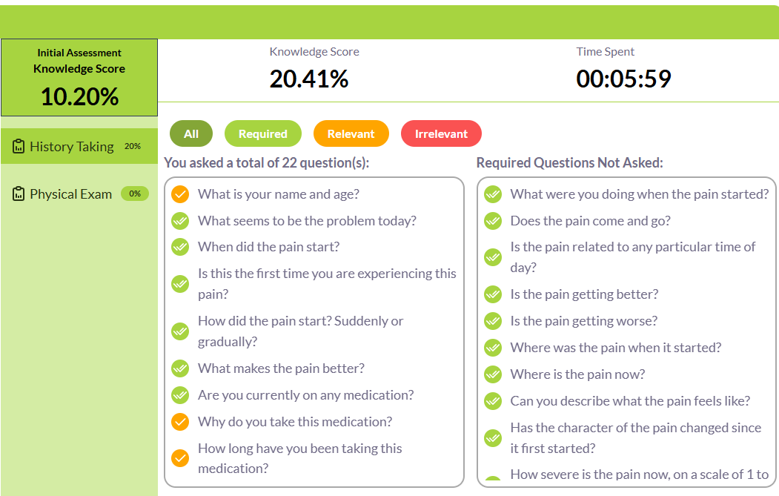
CyberPatient – Structured History Feedback
Notes:
Explain Feedback for Structured History Feedback

Slide 16
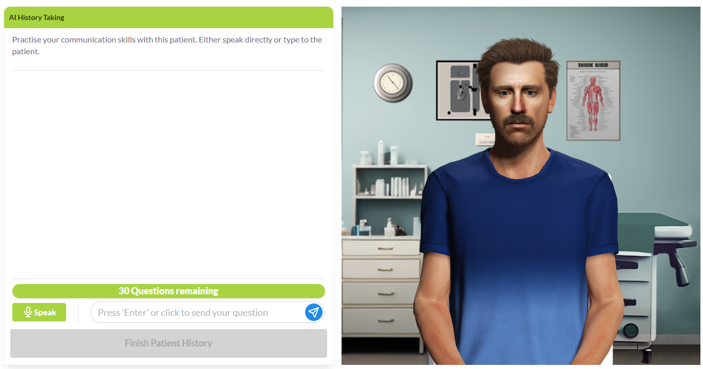
CyberPatient – AI Free-Form Communication
Notes:
•After the students have practiced with the click through structured option, then they move on to interacting with virtual patients where they have a free-form conversation.
•This time the system allows the student to speak directly with the virtual patient, using their own question formations and language practiced in the course.
•Importantly, for students with limited English proficiency, this exercise supports language development by exposing them to both written and spoken examples of appropriate, culturally sensitive patient communication. It builds their confidence and helps them practice meaningful interactions in a supportive setting.
Demo link if needed - https://learn.cyberpatient.ca/communication/68346470d9ab0fa516c841f4

Slide 17
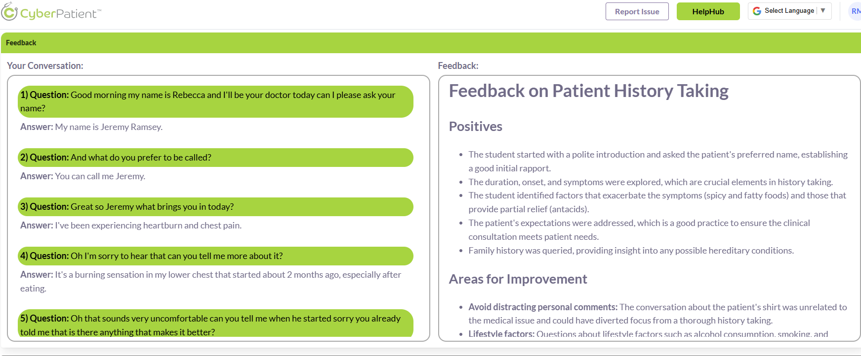
CyberPatient – AI Free-Form Feedback
Notes:
Explain Feedback for AI Free-Form Feedback

Slide 18
Conclusion
We have enhanced our ability to deliver flexible, innovative, and effective healthcare communication training based on need.
We have turned challenges into opportunities with purposeful use of innovations and technology to bridge gaps and offer inclusive and accessible courses.
We are better able to support doctors, pharmacists and nurses on their journeys to licensure nationally.
Notes:
In conclusion, this project has been quite successful so far….

Slide 19


Thank you!
Questions?
National Healthcare Language Program
Notes:
Thank you so much for joining us. If anyone has any questions, we’d be happy to answer them now.

