Slide 1


Slide 2
The Quinte Local Immigration Partnership QLIP
The Quinte LIP
Is comprised of a group of significant local stakeholders
    Who meet regularly to develop an approach to immigration and integration that fits the needs of the greater Quinte area
The QLIP Partners are committed to ensuring that the QLIP local immigration strategy and action plan is:
    Coordinated
    Comprehensive and
    Strategic

Slide 3
The Quinte Local Immigration Partnership QLIP
The LIPs are an initiative of Citizenship and Immigration Canada
The LIPs include 45 Partnerships across Ontario with 16 in the Toronto area
The LIPs are located in 29 regional centres including: Quinte, Kingston, Smith Falls, Brockville, Peterborough, and many more
The Quinte LIP is working with QUIS the Quinte United Immigrant Services
The Quinte LIP is designed to encourage the greater Quinte area to develop a comprehensive community plan for the delivery of newcomer services

Slide 4
A brief History of projects related to immigration strategies in the Quinte region
In 2007:
QUIS formed a group of Quinte area stakeholders to work with the three levels of government focused on attracting foreign investors to the greater Quinte area.
This group was later re-established as the Quinte Regional Immigration Advisory Committee QRIAC
The QRIAC included representatives of the Counties, Municipalities, the Provincial and Federal government , Loyalist College, and the School Boards to investigate the possibility of a future immigration strategy for the Quinte area’s development.
.

Slide 5
In 2009:
The QRIAC formed a smaller group with the Quinte West Chamber of Commerce as the lead for a new project - the Global Experience @ Work (GE@W) Project Quinte
In 2010:
The funding application for the GE@Work Project Quinte was approved and the year long project was successfully concluded as scheduled.
In 2011:
At the end of the GE@W Project Quinte a new funding application was approved and the Committee became the Quinte Local Immigration Partnership QLIP with funding and support from Citizenship and Immigration Canada.

Slide 6
QLIP - Participants in our community include:
Belleville & Quinte West Community Health Centre
The Hastings & Prince Edward Counties Health Unit
Community Employment Services - Loyalist College
Loyola School of Adult and Continuing Education
TESL Teachers of English as a Second Language - Kingston
Quinte & District Rehabilitation Inc.
City of Belleville
City of Quinte West
East Central Ontario Training Board
Corporation of Hastings County
Quinte Economic Development Commission

Slide 7
QLIP – Participants continued
Quinte Manufacturers Association
Manufacturers Resource Center
Loyalist College
Quinte United Immigrant Services
Quinte West Chamber of Commerce
Prince Edward County Chamber of Tourism & Commerce
Community Advocacy and Legal Centre
Community Development Council of Quinte
Citizenship and Immigration Canada
Corporation of the County of Prince Edward
Francophone Immigration Support Network of Eastern Ontario

Slide 8
Objectives of the Local Immigration Partnership
Improve access to, and coordination of, effective services that facilitate immigrant settlement and integration.
Identify labour market shortages that cannot be accommodated from the local workforce inventory and based on the research information strengthen labour market outcomes for newcomers to the greater Quinte region to eliminate shortages as they become a reality
Strengthen local and regional awareness and
capacity to integrate immigrants.

Slide 9
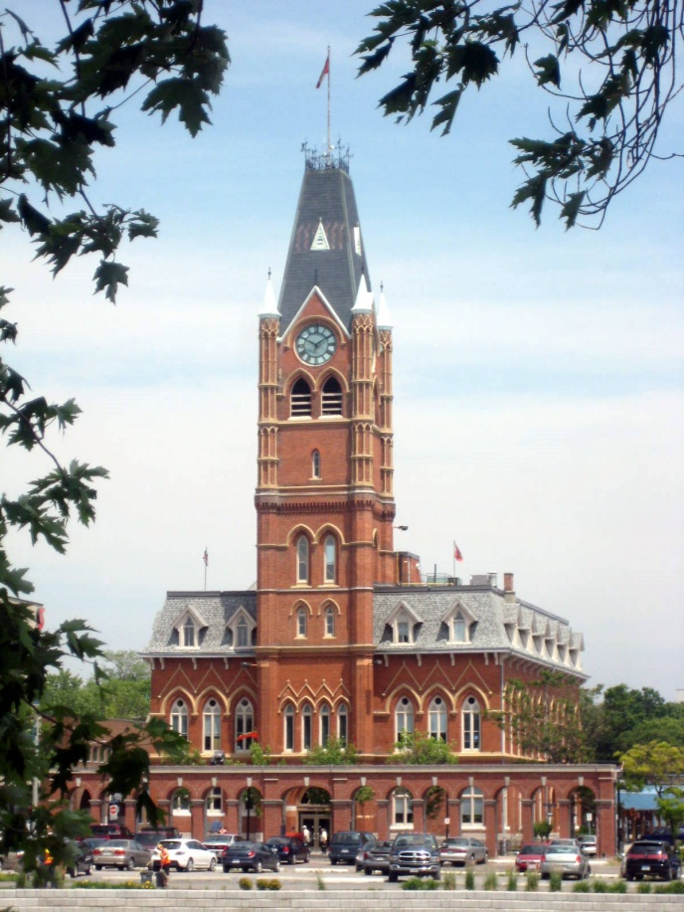
How can the Quinte LIP assist our municipalities and counties in setting a strategic regional immigration plan?
With the dynamic changes in the Federal immigration policies and programs the QLIP becomes an even greater asset for economic development and labour market integration within the context of sustainable economic development
for the greater Quinte area.

Slide 10
Assisting our local municipalities and counties
Future global economic sustainability will depend heavily on a renewable labour force.
Municipalities will compete to attract and retain excellent employers, acquire new business and ongoing investments.

Slide 11
The Quinte Local Immigration Partnership:
monitors the regional labour market needs in relation to the recruitment of newcomers as needed to eliminate shortages as they become a reality.
ensures that the services are in place to promote a safe and efficient integration of newcomers to the community.

Slide 12
The Quinte Local Immigration Partnership:
works to attract and retain newcomers by working with the different levels of government to facilitate the adoption of an immigration strategy by local municipalities.
is finalizing strategic recommendations for municipalities in the greater Quinte area that can provide the foundation of a local immigration strategy

Slide 13
The QLIP seeks your support
The QLIP Settlement Strategy and Action Plan will soon be communicated and made available on the QLIP website to be launched this summer.
The QLIP seeks your support in considering the QLIP Local Settlement Strategy and Action Plan as a reference in the formulation of a local or regional strategic immigration plan.
Thank you for your time and consideration

