Slide 1
Canadian Network of National Associations of Regulators
Hon. Jean Augustine, PC, CM
Toronto, November 4, 2011

Slide 2
Agenda
Fair access law
Context
Continuous Improvement and Assessments
Conclusion

Slide 3
Fair access law
Fair Access to Regulated Professions Act, 2006
40 regulatory bodies
Transparent, objective, impartial and fair licensing
Everyone deserves fair treatment when applying to practise a profession, regardless of where he or she was educated.

Slide 4
Ontario Context
Ontario population: 12 million
Membership in regulated professions
  Largest: College of Teachers 230,000
  Smallest: College of Dental Technologists 500
Proportion of internationally educated members ranges from zero to 39 %.
In 2008-10, most applicants came from South Asia, U.S., South East Asia, East Asia

Slide 5
Progress
Regulatory bodies’ improvements:
  Reduced requirements for Canadian work experience
  Speeded up procedures
  Posted more information online
  Ensured that qualifications assessment agencies do their work fairly

Slide 6
Strategy for Continuous Improvement
Two-year cycle
  Assessment
  Meeting
  Recommendations, as needed
  Action plan
  Implementation and monitoring
Notes:
6

Slide 7
Assessment
Assessment Guides
  Allow OFC to assess consistently
  Help regulators understand legal requirements
  Based on provisions of the law

Slide 8
Assessment
“Required” licensing practices
“Good” licensing practices
Enforcement for failure to meet legal duties

Slide 9
Assessment

Slide 10
Conclusion
Ontario fair access law has been in place for four and a half years.
Regulatory bodies are making improvements.
Clear vision: everyone deserves fair treatment in registration and licensing.
Recommendations are practical and realistic.
Applicants will have faster, fairer access to the professions.

Slide 11
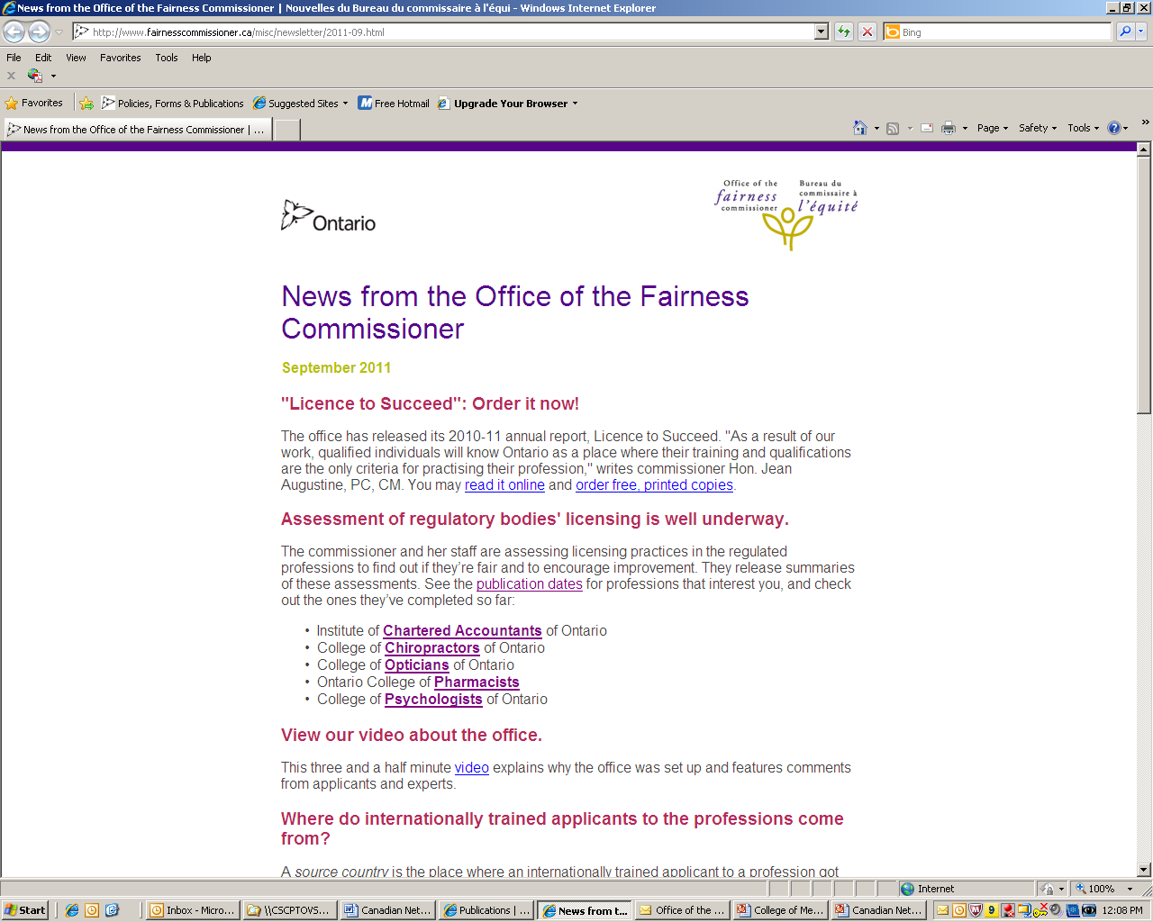
Newsletter
Office of the fairness commissioner
11
Sign-up www.fairnesscommissioner.ca
Notes:
We issue an electronic newsletter three times per year.
If you would like to get it … sign-up sheet or business card.
Next issue: later this month.

Slide 12
Contact
Hon. Jean Augustine, PC, CM
Office of the Fairness Commissioner
595 Bay Street, Suite 1201
Toronto, Ontario M7A 2B4
Canada
416-325-9380
ofc@ontario.ca
www.fairnesscommissioner.ca

