Slide 1
Welcoming Communities:
Same Ingredients, Different Recipes
Presented By: John Biles* (Integration Branch)
“Opening Doors: Creating Conditions for Success” Strathmore, Alberta
September 29-30, 2011
* Opinions expressed are those of the presenter, and do not necessarily reflect those of Integration Branch, Citizenship and Immigration Canada or the Government of Canada.

Slide 2
Contents
Why a Concern with Welcoming Communities?
  Demographics
Definitions
Ingredients
Sample Recipes?
Now You are Cooking
  Local Immigration Partnerships
  Canadian Coalition of Municipalities Against Racism and Discrimination
Alberta Ingredients
Developing Your Own Recipe?
Looking for the Appropriate Utensils
Chefs’ Notes
Thinking About Community Connections
Take Away Thoughts
Bibliography / Resources

Slide 3
Why a Concern with Welcoming Communities?
Labour market shortages (present and projected);
Limit of domestic growth, retraining, inclusion of marginalized workforces (Metis and Aboriginals), and internal migration;
Attraction of newcomers only useful if RETENTION challenge is resolved.
(Source: Schollie Research and Consulting 2010)

Slide 4
Why a Concern with Welcoming Communities? (cont.)
“Local government involvement in settlement services varies across the country, but all municipalities contribute whether through the provision of temporary shelter to refugees, grants to community-based organizations or program enhancements at local libraries or community centres – just to name a few” (FCM 2011)

Slide 5
Why a Concern with Welcoming Communities? (cont.)
“If you want to kill your community, however, it is critical that you emulate a type of behaviour that doesn’t welcome, engage, or support outsiders of any stripe, whether they are from out of town, out of the country, or just outside your generally travelled circles”.
Doug Griffiths and Kelly Clemmer 2010

Slide 6
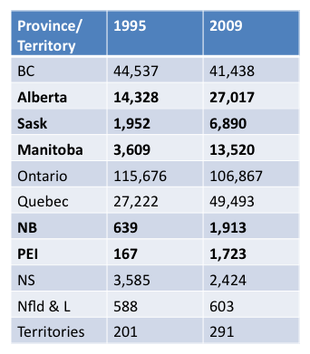
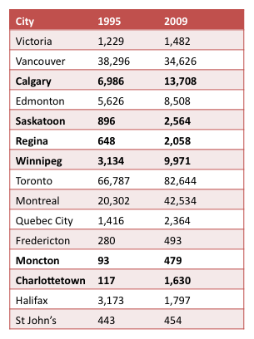
Demographics
Permanent Residents:
Intended Province of Destination
Permanent Residents
Intended City of Destination
Sources: Citizenship and Immigration Statistics 1995; Facts and Figures 2009

Slide 7
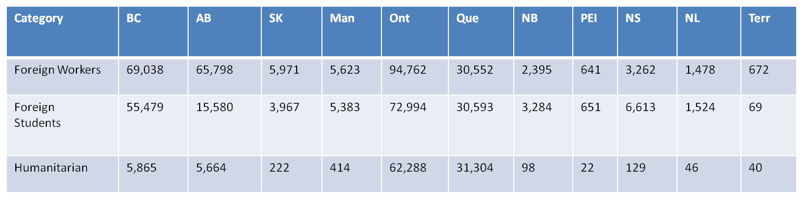
Temporary Residents By Province Present on December 1, 2009
Source: Facts and Figures 2009

Slide 8
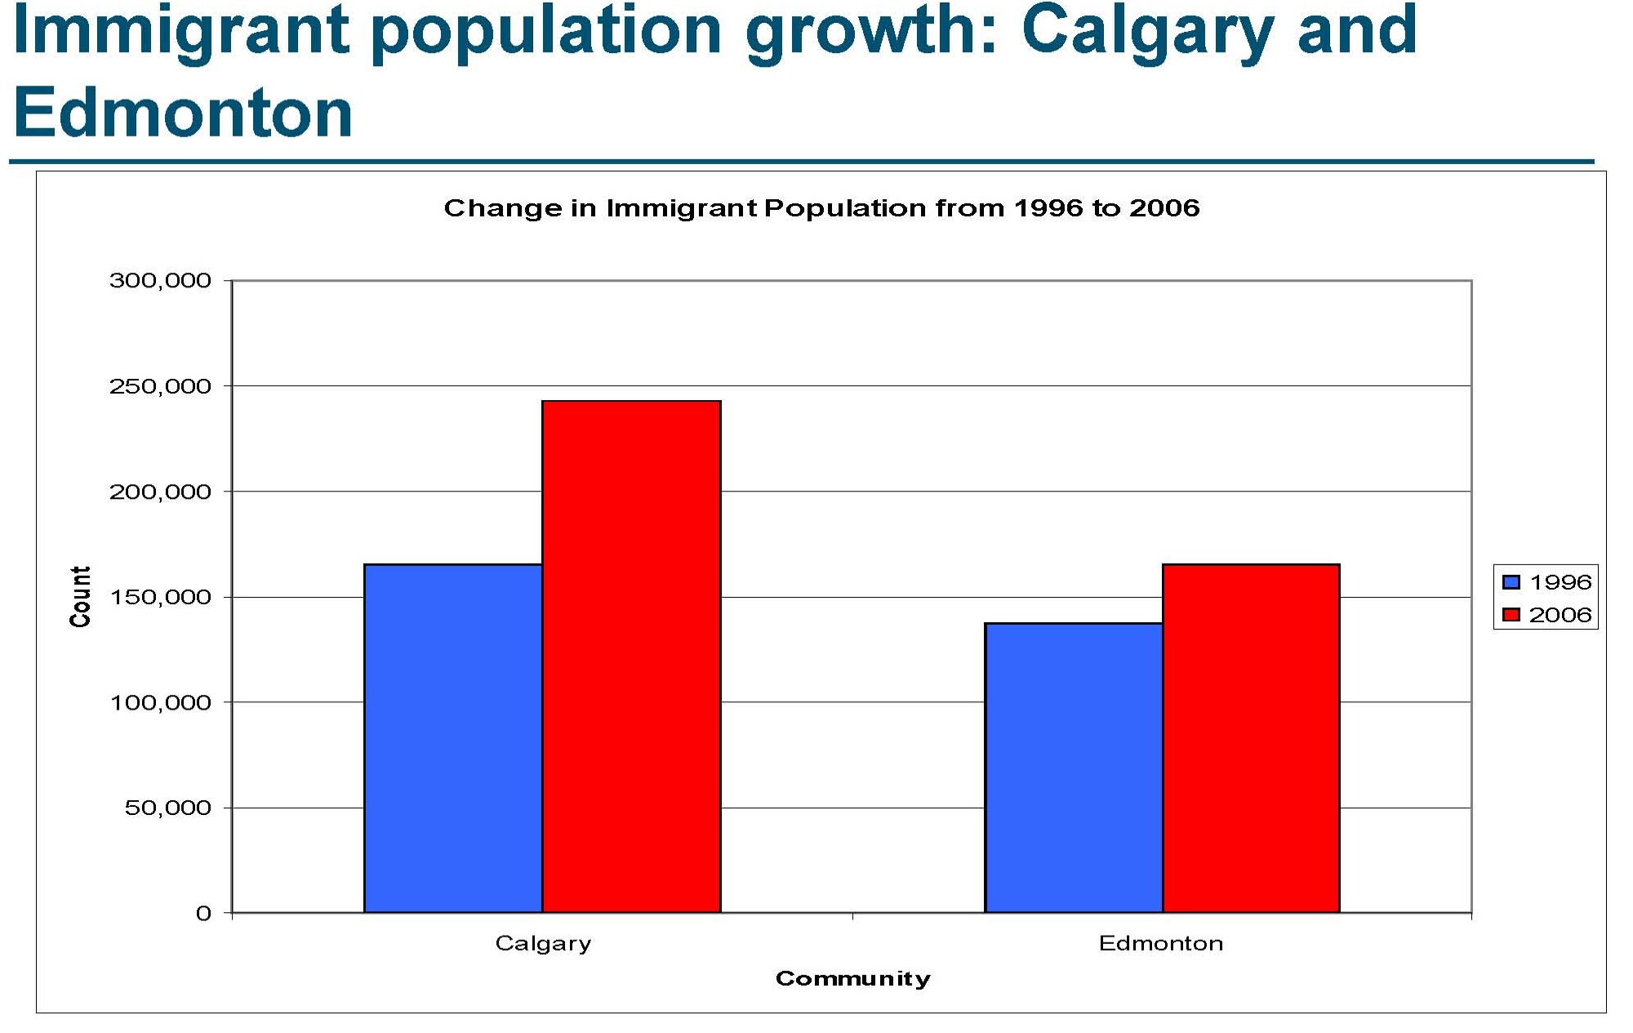
Alberta Demographic Snapshots
Source: Renwick 2010

Slide 9
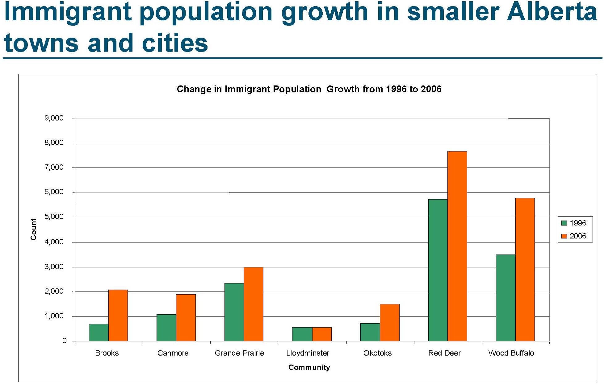
Alberta Demographic Snapshots
Source: Renwick 2010

Slide 10
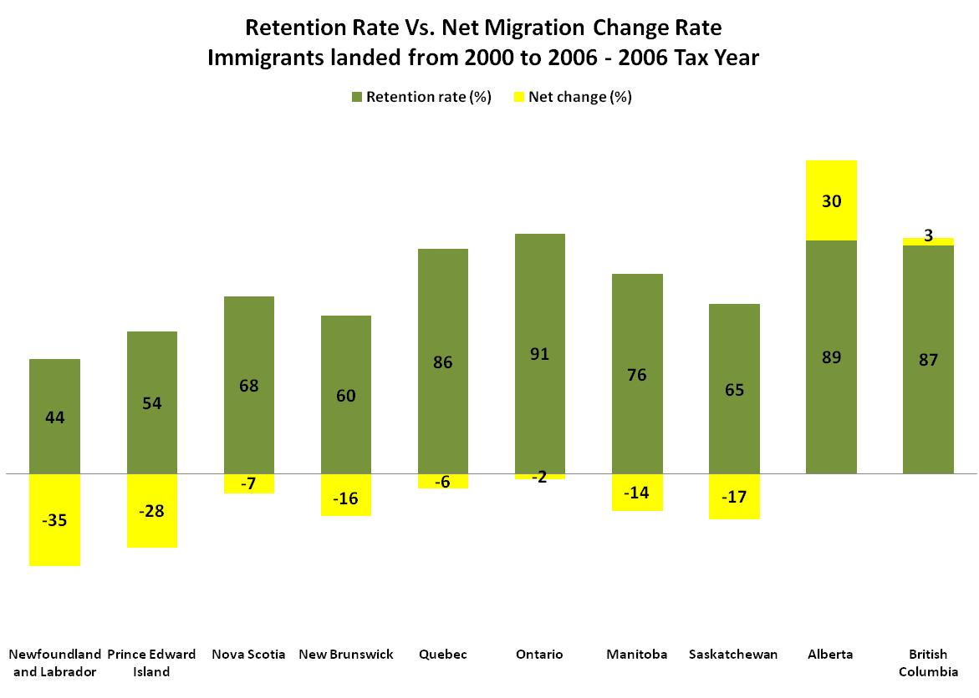
Secondary Migration
Source: Okonny-Myers 2010

Slide 11
Definition 1
Toolbox of Ideas for Smaller Centres (2007)
  A welcoming community:
    has a strong desire to receive newcomers and to create an environment in which they will feel at home;
    ensures newcomers are able to participate fully in all aspects of community life;
    Ensures newcomers have access to a full range of services and programs and can find meaningful employment opportunities.
    (Source: National Working Group on Small Centre Strategies 2007)

Slide 12
Definition 2
Welcoming Communities Initiative 2010
Spatial dimensions – a physical location in Canada – a town, city or region – in which newcomers feel valued and their needs are served
Discourse dimension – a community having agency and engaging in actions that facilitate the integration of newcomers
A collective effort to create a place where individuals feel values and included
A location that has the capacity to meet the needs and promote inclusion of newcomers, and the machinery in place to produce and support these capacities; includes both outcomes and processes that work toward producing and maintaining these outcomes
(Source Esses et. al 2010)

Slide 13
Ingredients
Employment opportunities
Fostering social capital
Affordable and suitable housing
Positive attitudes towards immigrants, cultural diversity and the presence of newcomers in the community
Presence of newcomer-serving agencies that can successfully meet the needs of newcomers
Links between main actors working towards welcoming communities
Municipal features and services sensitive to the presence and needs of newcomers
Educational opportunities
Accessible and suitable health care
Available and accessible public transportation
Presence of diverse religious organizations
Social engagement opportunities
Political participation opportunities
Positive relationships with the police and the justice system
Safety
Opportunities for use of public space and recreational facilities
Favorable media coverage and representation
(Source Esses et. al 2010)

Slide 14
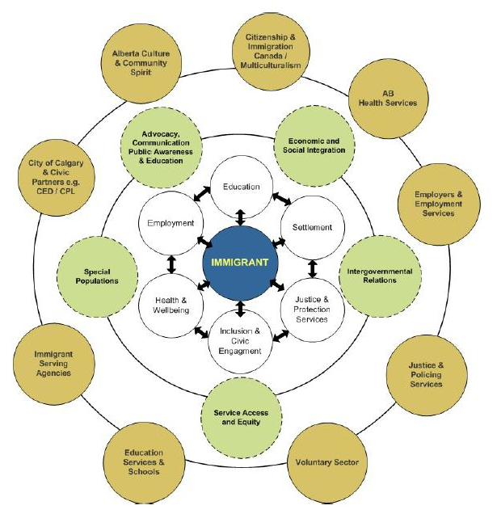
Organizing the Ingredients
INSERT Calgary Model
Source: City of Calgary 2011

Slide 15
Sample Recipes?
ALBERTA
Brooks (Conference Board 2009, Broadway 2009)
Calgary (City of Calgary 2011)
Edmonton (FCM 2011, Derwing and Krahn 2006)
High River (Edna Sutherland and Associates 2007)
Innisfail (Govt of BC N.D.; Churchill 2008; Ashworth 2008)
Red Deer (City of Red Deer 2007)
BRITISH COLUMBIA
Burnaby (Ashworth 2008; Govt of BC N.D.)
Coquitlam (Ashworth 2008)
Delta (Ashworth 2008)
Kamloops (Drolet 2010)
Kelowna (Bahbahani 2008)
New Westminister (Ashworth 2008)
North Vancouver (Ashworth 2008)
Prince George, Fort St John and Terrace, BC (McCallum 2009)
Richmond (Ashworth 2008; Good 2007)
Surrey (Ashworth 2008; Good 2007)
Upper Skeena (Govt of BC N.D.)
Vancouver (Ashworth 2008; Good 2007)
Revelstoke (Pearce 2005; Kline and Whalen 2010)
Vancouver (Govt of BC N.D.)
SASKATCHEWAN
Saskatoon (AUMA 2008, Garcea 2006)
Regina (Garcea 2006)
MANITOBA
Brandon (Zehtab-Martin and Beesley 2007)
Parkland, Portage la Prairie, Steinbach, Winkler* (FCM 2011)
Winkler (Conference Board 2009)
Winnipeg (FCM 2011)
NORTHWEST TERRITORIES
Yellowknife (Conference Board 2009)
NOVA SCOTIA
Cape Breton (Strait-Highlands Regional Development Agency 2007)
Colchester County (Flint 2007)
Halifax (Krnstal 2010; AUMA 2008, Coutinho 2006; Hornberger 2005a, 2005b)
NEW BRUNSWICK
Florenceville-Bristol (Conference Board 2009)
Moncton (Belkhodja 2006)
Saint-Leonard (Govt of BC N.D.)
QUEBEC
Montreal (FCM 2011)
Quebec City (Gignac 2010, Bourget 2006)
Sherbrooke (Govt of BC N.D.; Corriveau and Rougery 2006)
Notes:
* http://www.brandonu.ca/rdi/publications/rural-immigrationrural-migration/

Slide 16
Sample Recipes? Ontario
Brampton (Good 2007)
Brantford and Brant-Haldimand-Norfolk Counties (Sethi 2009)
Guelph (Lusis and Bauer 2012, Guelph-Wellington Local Immigration Partnership 2010; Guelph 2006)
Hamilton (Bird 2012, Hamilton Immigration Partnership Council 2010; AUMA 2008, Satzewich and Shaffir 2007)
Hearst, Timmins and Kapaskasing (Lacassagne forthcoming)
Kingston (Kobayashi 2012)
London (Bradford and Esses 2012, London & Middlesex Local Immigration Partnership 2010; Brochu and Abu-Ayyash 2006)
Markham (Good 2007)
Mississauga (Good 2007)
Niagara (Niagara Local Immigration Partnership 2011)
North Bay (North Bay Newcomers Network 2011)
Ottawa (Biles, Tolley, Andrew 2012; Ottawa Local Immigration Partnership 2011)
Peel (Agrawal et. al. 2007)
Peterborough (Ma 2012; PPCII 2010)
Sarnia-Lambton (County of Lambton 2010)
Sault Ste Marie (Sault Ste Marie Local Immigration Partnership 2011)
Sudbury (Nangia 2012, Block 2006)
Thunder Bay (Southcott 2012,Tunder Bay Immigration Committee 2010; Dunk 2007)
Timmins (Timmins Economic Development Corp 2011)
Toronto (Siemiatycki 2012; Good 2007)
Waterloo (Janzen and Walton-Roberts 2012; McFadden and Janzen 2007; Abu-Ayyash and Brochu 2006)
Windsor (George and Ku 2012)

Slide 17
Now You’re Cooking: Overview
WCI Five Stages of developing a welcoming communities approach:
  Assessment of the current state of the community at a global and specific level
  Creation of short-term and long-term goals
  Implementation (adjustment) of policies and programs that are designed to target gaps and weaknesses and work toward these goals
  Systematic research to evaluate the effectiveness of these policies and programs
  On-going assessment of community outcomes and feedback
  (Source Esses et. al 2010)

Slide 18
Examples
Local Immigration Partnerships (LIPs)
Canadian Coalition of Municipalities Against Racism and Discrimination (CMARD)

Slide 19
Local Immigration Partnerships
  Through regional CFPs for LIPs in 2008 and 2010, 45 LIPs have been gradually established in Ontario.
  In issuing the Calls for Proposals, CIC intended to:
  Strengthen local and regional awareness and capacity to integrate immigrants.
  Establish or enhance partnerships and participation of multiple stakeholders in planning, and coordinating the delivery of integration services.
  Improve access to, and coordination of, effective services that facilitate immigrant settlement and integration.
  Improve access to the labour market for immigrants.
For more details on LIPs see Burr 2011

Slide 20
  Partnership Council Membership
    Municipal representatives
      Elected city officials or bureaucratic representatives involved with economic development, social planning or public services (transit, housing, libraries, police, social services)
    Provincial representatives
      Immigration, health, justice, education and training, school boards, regional economic development agencies
    Federal representatives
      CIC, HRSDC, Service Canada, PHAC, Agriculture and Agri-food Canada (Rural and Co-operatives Secretariat), PCH, regional economic development agencies
    Labour market actors
      Employers, training boards, business councils and associations, chambers of commerce and unions
    Local SPOs
      e.g. Catholic Immigration Centre
    Umbrella organizations
      e.g. United Way, social planning councils
    Local and regional research bodies
      Universities, colleges, think tanks, WCI CURA
    Mainstream and Ethnic Media

Slide 23
Commonalities within LIPs Strategies
Common Themes | Priorities
Accessibility and Coordination of Settlement Services | Establish Welcome Centres Develop common referral systems - “no wrong door” Promote “one-stop shop” approach Create multi-lingual materials and services
Employment | Engage employers Offer training and resources Assist with occupation-specific language training Encourage mentoring, bridging and job shadowing for employment
Host Community | Engage community Develop public awareness campaigns
Language Training | Evaluate local language training programs Explore alternative models of language training Enhance availability of childcare and review location of classes
Mainstream Services | Housing – locate suitable housing; increase availability of affordable housing; offer training regarding tenant/landlord issues. Healthcare – assist newcomers in understanding the system; increase accessibility; address mental health needs. Transportation: provide orientation to systems; decrease barriers to usage. Education – collaborate with school boards. Public Services – provide translation and interpretation.

Slide 24
CMARD
As of 2011 there were 47 Canadian Signatory Municipalities
Alberta: Brooks, Calgary, Drayton Valley, Edmonton, Fort McLeod, Grande Prairie, Innisfail, Lethbridge, St Albert, the Region of Wood Buffalo and Fort McMurray, and Wetaskwin
British Columbia: Lions Bay, Vancouver, Williams Lake
Manitoba: Winnipeg
New Brunswick: Saint John
Nova Scotia: Halifax, Kentville, Kings, Truro
Ontario: Aurora, Caledon, Georgina, Kingston, London, Markham, Oakville, Oshawa, Peel, Richmond Hill, Sudbury, Tecumseh, Thunder Bay, Toronto, Vaughan, Windsor
Prince Edward Island: Stratford
Quebec: Gatineau, Montreal, Quebec City, Saguenay, Saint-Justin, Sherbrooke
Saskatchewan: Moose Jaw, Prince Albert, Saskatoon
(Sources:Alberta Human Rights Commission; Lacasse 2011)
Notes:
Common Commitments
The municipality as an organization in the fulfillment of Human Rights will:
Provide equal opportunities as a municipal employer, service provider and contractor.
Support measures to promote equity in the labour market.
Support measures to challenge racism and discrimination and promote diversity and equal opportunity in housing.
The municipality as a community sharing responsibility for respecting and promoting Human Rights and diversity will:
Involve citizens by giving them a voice in anti-racism initiatives and decision-making.
Support measures to challenge racism and discrimination and promote diversity and equal opportunity in the education sector and in other forms of learning.
Promote respect, understanding and appreciation of cultural diversity and the inclusion of Aboriginal and racialized communities into the cultural fabric of the
municipality
(Source: CMARD 2011a)
Common Declaration
Be it resolved that:
The Municipality of ___________agrees to join the Coalition of Canadian Municipalities Against Racism and Discrimination and, in joining the Coalition, endorses the Common Commitments and agrees to develop or adapt its own unique Plan of Action accordingly.
These Common Commitments and the Municipality's unique Plan of Action will be an integral part of the Municipality's vision, strategies and policies.
In developing or adapting and implementing its own unique Plan of Action toward progressive realization of the Common Commitments, the Municipality will cooperate with other organizations and jurisdictions, including other levels of government, Aboriginal peoples,3 public and private sector institutions, and civil society organizations, all of whom have responsibilities in the area of human rights
.The Municipality will set its priorities, actions and timelines and allocate resources according to its unique circumstances, and within its means and jurisdiction.
The Municipality will exchange its expertise and share best practices with other municipalities involved in the Coalition and will report publicly on an annual basis on actions undertaken toward the realization of these Common Commitments.
(Source: CMARD 2011b)

Slide 25
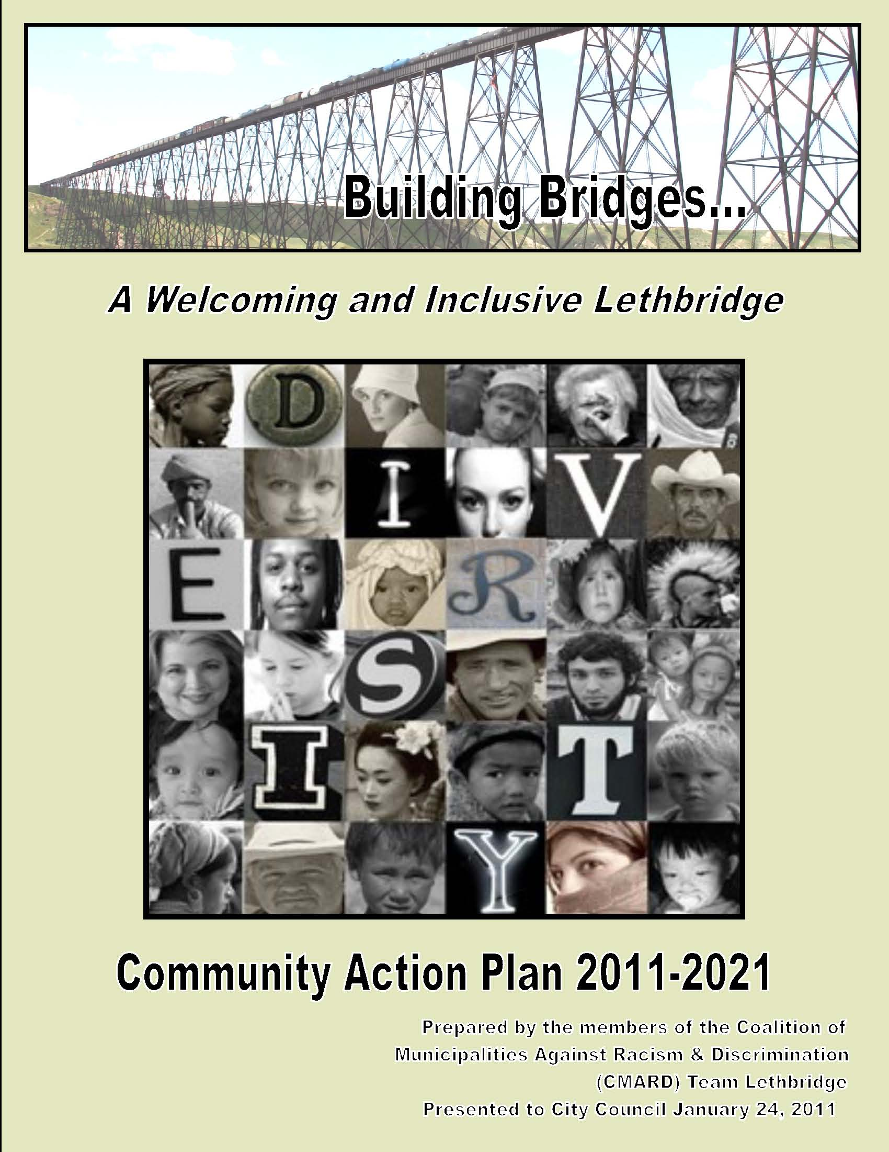
CMARD: Lethbridge Strategy

Slide 26
Membership of Lethbridge CMARD Committee
City of Lethbridge
Lethbridge Regional Police Service
University of Lethbridge
Persons with Developmental Disabilities
Youth and Community Service Groups
Aboriginal Council of Lethbridge
Lethbridge Family Services/Immigrant Services
Gay and Lesbian Alliance of Lethbridge and Area
Southern Alberta Ethnic Association
Blood Tribe
Downtown Lethbridge Business Revitalization Zone
(Source: City of Lethbridge 2011)

Slide 27
Developing the Plan
Broadly representative committee
“Building Bridges . . . Finding Common Ground: Celebrating Diversity in Our Community” Conference (2010)
Pangaea Diversity Cafes
(Source: City of Lethbridge 2011)

Slide 28
Components of the Plan
  Leadership on behalf of municipality
  Needs assessment and asset mapping
  Workplace survey
  Annual diversity, inclusion report card
  Implement Safe Harbour Program
  Community partnerships
  Social marketing campaign
  Development/distribution of resource materials
  Community forums / annual conference
  Calendar of important events
Notes:
Safe Harbour: Respect for All is about a vision in action: creating opportunities for businesses, institutions, agencies, and municipalities to be proactive in creating welcoming and inclusive workplaces and communities. Building on roots in 24 communities in British Columbia, Safe Harbour: Respect for All continues to expand and grow recognition, coordinated by the Affiliation of Multicultural Societies and Service Agencies of BC, an affiliation of 75 multicultural agencies providing immigrant settlement and multicultural services. Community Organizers, not-for-profit agencies who serve newcomers, multicultural, Aboriginal and underserved populations, deliver the two-hour Safe Harbour: Respect for All workshop to one or more representatives from businesses, financial institutions, agencies, libraries, government offices, policing stations and other local organizations, helping them to create an inclusive workplace environment where employees, customers and clients of diverse backgrounds know that they will be respected and safe from discrimination. The workshop not only explores stereotyping, privilege, marginalization, but also offers ways to improve customer service by providing equitable treatment to all. Safe Harbour locations sign on to three key commitments: Equitable Treatment for All: Welcoming all clients and/or customers in a respectful manner. If a concern is expressed regarding a lack of respectful treatment, employers and staff take steps to address it. An Immediate Safe Place: For someone experiencing discrimination in or near the worksite which may include a place to sit, a glass of water, a phone to use, and access to a list of resources. Prepared Employees and Worksites: Preparing all staff to implement these commitments.

Slide 29
Components of the Plan (cont.)
  Development/training/community involvement of diversity unit and other regional law enforcement bodies.
Provide equal opportunity as a municipal employer, service provider and contractor
Support measures to promote equity in the labour market
  Identify and remove systemic barriers
  Civic participation and leadership development

Slide 30
Components of the Plan (cont).
  Support for community-based projects
  Recognition programs
  Youth-at-risk programming
  Pool of experts
  Cultural competency training
  Equitable support to cultural projects, programs and events
  Best practices, evaluation and reporting

Slide 31
Developing Your Own Recipe
Source Your Ingredients Locally (if possible)
Select/Develop Appropriate Utensils
Read Chefs’ Notes (Your Own and Others’)

Slide 32
Alberta Ingredients
Prairie Metropolis Centre (www.pcerii.metropolis.net)
Alberta Association of Immigrant Serving Agencies (www.aaisa.ca)
Northeast Alberta Information HUB’s 2010 Labour Force Capacity Study for Rural Communities (Schollie Research and Consulting 2010)
Alberta Urban Municipalities Association’s 2008 Welcoming and Inclusive Communities Toolkit
Human Rights, Citizenship and Multiculturalism’s Education Fund and the Creating Inclusive Communities Framework for the Future: 2007-2012 (Alberta 2006a, b; 2007)
Alberta Rural Physician Action Plan (http://www.rpap.ab.ca/)
Welcoming and Inclusive Communities Initiative*
(http://www.auma.ca/live/AUMA/Toolkits+%26+Initiatives/Welcoming+and+Inclusive+Communities)
Notes:
Fiscal 2011/2012 $300,000 grant to AUMA to develop on-line resources and 4 best practice videos
End of November – Beginning of December will host a best practices conference.
Contact: Mark Colbourne (mcolbourne@auma.ca)

Slide 33
Looking for the Appropriate Utensils
Community Dialogue (Canada’s Rural Partnership 2001)
Getting the Basic Facts
  Prairie Metropolis Centre* (www.pcerii.metropolis.net)
  Labour Force Capacity Study for Rural Communities
  Brandon University’s Rural Development Institute
  Our Diverse Cities magazines
  Welcoming Communities Initiative (www.welcomingcommunities.ca)
Attraction (Twist Marketing 2009)
Focusing Upon Specific Sub-populations of Newcomers
  Francophone Minority Communities (Belkhodja and Beaudry 2008; Belkhodja 2008; Roy 2007)
  International Students (Arias 1999)
  Provincial Nominees (Carter 2008)
  Refugees (Sherrell et. al. 2005; Abu-Laban et. al. 1999)
  Secondary Migration (Newbold 2007)
  Temporary Foreign Workers (Govt of Alberta 2010)
Notes:
Abu-Laban, Baha, Tracey Deriwng, Harvey Krahn, Marlene Mulder and Lori Wilkinson 1999. “The Settlement Experiences of Refugees in Alberta” http://pcerii.metropolis.net/Virtual%20Library/RefugeeStudy/index.htm
In its 15 years of operation the Prairie Metropolis Centre has conducted hundreds of research students on immigration, integration and settlement on the Prairies. Examples include:
Derwing, Tracey and Harvey Krahn. 2006. “Edmonton’s Approach to Attracting and Retaining New Immigrants” Our Diverse Cities Volume 2: 9-13.
Garcea, Joseph. 2007. “Immigration to Smaller Communities in Saskatchewan” Our Divers Cities 3: 134-139.
Garcea, Joseph. 2006. “Attraction and Retention of Immigrants by Saskatchewan’s Major Cities” Our Diverse Cities Volume 2: 14-19.
Krahn, Harvey, Tracey Derwing and Baha Abu-Laban 2005 “The Retention of Newcomers in Second and Third-Tier Canadian Cities” International Migration Review 39(4): 872-894.
Plaizier, Heather Mae. 2009. “Developing a Sense of Place in Rural Alberta: Experiences of Newcomers” Unpublished M.Ed thesis, University of Alberta
The RDI has a series of papers and presentations that can be found on-line at http://www.brandonu.ca/rdi/publications/rural-immigrationrural-migration/
Our Diverse Cities are bilingual magazine publications of the Metropolis Project that feature a wide range of articles by researchers, policymakers and service provider organizations. Of particular note are issue 2 focused on second and third tier cities, issue three focused on rural communities and issue six focused on the prairies. They are available on-line at www.metropolis.net

Slide 34
Looking for the Appropriate Utensils (cont.)
Developing the Plan
  Welcoming and Inclusive Communities Toolkit (AUMA 2008)
  Small Centres Tool Kit 2007
Engaging Key Partners
  Small and Medium Sized Enterprises (Shukla 2010; Govt of Alberta 2010; ATESL 2006)
  Universities and Colleges (Walton-Roberts 2008; City of Red Deer 2007; Kebrun and Rebelo 2006)
  Ethnocultural Organizations (Bucklaschuk and Sormova 2011)
  School Boards (Coalition for Equal Access to Education 2009; Kappel Ramji Consulting Group 2008; Ngo 2003)
  Libraries (Library Settlement Partnership No Date; Power Analysis Inc., 2007, Toronto Public Library 2007)
  Immigrant Serving Agencies www.aaisa.ca

Slide 35
Looking for the Appropriate Utensils (cont.)
Best Practices & Evaluation
  Characteristics of a Welcoming Community (Esses. Et. al. 2010)
  Welcoming Communities Initiative (www.welcomingcommunities.ca)
  Pathways to Prosperity Proposal
  (vesses@uwo.ca; lenise@ualberta.ca)

Slide 36
Chefs’ Notes
Conference Board of Canada’s 2009 Immigrant-friendly Communities: Making Immigration Work for Employers and Other Stakeholders in Small-Town Canada
  There is no cookie-cutter approach or model of building an immigrant-friendly community in small-town Canada.
  Immigration needs to be a part of a community’s longer-term economic development strategy if it is going to succeed.
  Employer engagement, along with the concerted support and efforts of many different community stakeholders, is needed to attract, settle, integrate and retain immigrant talent.
  Building a critical mass of immigrants in a community is important for long-term success, as most immigrants choose destinations based on the presence of ethnic networks.

Slide 37
Chefs’ Notes (cont.)
Small Centre Strategy (2003/2007)
  “The resources (the ‘tools’) are, or can be made available, if the will is present. But an organized effort is also required. Good intentions or a positive philosophical framework are obviously important and may indeed be readily achieved. But if there is no coherent plan, and a co-ordinating and implementing structure in place with strong leadership to make it work, then the good intentions may yield little.”

Slide 38
Chefs’ Notes (cont.)
AUMA Toolkit (2008)
  Leadership engagement
  Shared vision
  Linking to existing priorities, initiatives and networks
  Reaching out: Local ownership and active partnerships
  Informed decision-making
  Demonstrating commitment

Slide 39
Chefs’ Notes (cont.)
Innisfail
  “Don’t get bogged down with structures and funding. Start with quick wins. Try to get the right people around the table. Make sure you have a passionate supporter from town council on the committee” (Ashworth 2008).

Slide 40
Thinking About Community Connections for Newcomers
A program that has a specific focus , targeted modes of delivery, with effective assessment in order to :
Component 1 Universal
(Low needs and broad access)
Promotes
civic values & volunteerism in
local community
Component 1. Provide newcomers with the information they need to take responsibility for engaging in their local community
Component 2. Promote the integration of newcomers into Canadian society through referrals to a range of local, community based program options
Component 3. Actively combat isolation among vulnerable newcomers through community based mentorship programs
Component 2 Tailored Bridging
(Citizenship courses
& ceremonies,
Language
curricula,
Settlement
Information
Resources,
Service
Canada)
Refers
clients to local community
resources as
needed
(ref: SWIS,
NOW, WIN)
Component 3 Targeted
(High needs and limited access)
Group mentorship of vulnerable clients
(suffering of trauma, illiterate, handicapped, isolated women/elderly
  /youth

Slide 41
CIC Settlement Program Best Practices
Welcoming Communities Initiative – projects aim to address racism and discrimination as key barriers to settlement and integration.
  Toolbox of Ideas for Smaller Centres
  The Caravan
Local Immigration Partnerships – partnership between municipalities and local stakeholders to develop a comprehensive, coordinated and collaborative strategy for the settlement and integration of newcomers to their communities.
Settlement Workers in Schools (SWIS) / In-School Supports – partnership that seeks to increase access to settlement services by providing information, counselling and referral to newcomer children, youth, and their families directly in schools.
  Newcomer Orientation Week
Library Settlement Partnerships (LSP) – three way partnership between immigrant settlement agencies, CIC and participating public library systems to provide information, referral, and community outreach based on community needs.
Welcome Centres – local centres that offer one-stop shops for community information and settlement services, such as language training or job-search workshops.
  Four new centres announced in York Region
Tunis 2010

Slide 42
Related Initiatives
The modernized Settlement Program is complemented by regional strategies led by some provinces. For example:
  Welcome BC Engages diverse sectors and groups to enhance social cohesion by funding projects that foster inclusive and vibrant communities (www.welcomebc.ca).
  Welcoming Communities Manitoba Initiative Provides funding to a wide range partners undertaking activities that build capacity to address discrimination, support social inclusion or increase public education and awareness
  (http://www2.immigratemanitoba.com/asset_library/en/multiculturalism/pdf/wcm_guide050109.pdf).
  Saskatchewan’s Community Connections Program Supports the goals of integration and retention by funding projects that increase newcomers' sense of belonging by actively engaging them in the planning and delivery of local projects
  (http://www.aeei.gov.sk.ca/community-connections-program).
  Quebec’s Regionalization Initiatives Includes regional conferences of elected officials, and some municipalities have signed three-year immigration agreements with the provincial immigration ministry (Vatz-Laaroussi and Bezzi 2010; Rimok and Rouzier 2008; Allen and Troestler 2007).

Slide 43
Take Away Thoughts
Attraction is insufficient, you must also pay attention to retention
You never get a second chance to make a first impression
Connecting the dots matters
Leadership matters
Developing a plan and appropriate governance are key
Performance measurement and learning from others improves odds of success
Get started – your colleagues and competition have already done so!

Slide 44
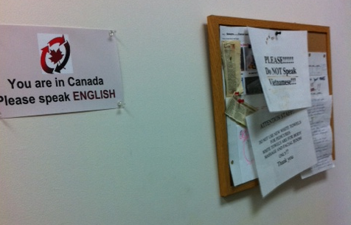
ANNEX: How Not to Make First Impressions
Source: Sister-in-law of presenter, 2011

Slide 45
Bibliography
Abu-Ayyash, Caroline and Paula Brochu. 2006. “The Uniqueness of the Immigrant Expeirence Across Canada: A Closer Look at the Region of Waterloo” Our Diverse Cities Volume 2: 20-26.
Abu-Laban, Baha, Tracey Deriwng, Harvey Krahn, Marlene Mulder and Lori Wilkinson 1999. “The Settlement Experiences of Refugees in Alberta” http://pcerii.metropolis.net/Virtual%20Library/RefugeeStudy/index.htm (accessed 27 September 2011).
Agrawal, Sandeep Kumar, Mohammad Qadeer and Arvin Prasad. 2007. “Immigrants’ Needs and PublicS ervice Provisions in Peel Region” iOur Diverse Cities Volume 4: 108-112.
Alberta Human Rights Commission. 2011. “List of Signatory Municipalities Who Have Joined CCMARD” http://www.albertahumanrights.ab.ca/List_of_Signatory_Municipalities_English_French_Aug_2011.pdf (accessed 23 September 2011).
Alberta Urban Municipalities Association. 2008. “Welcoming & Inclusive Communities Toolkit” http://www.auma.ca/live/digitalAssets/25/25953_WICT_booklet_10232008.pdf (Accessed 22 September 2011).
Allen, Bertrand and Hbert Troestler. 2007. “On the Ground with the Quebec Government’s Immigration Regionalization Strategy” Our Diverse Cities Volume 3: 64-69.
Andrew, Caroline, John Biles and Erin Tolley. 2012. “Follow the Leader? Immigration, Integration and Inclusion in Ottawa” in Caroline Andrew, John Biles, Meyer Burstein, Victoria Esses and Erin Tolley eds. Immigration, Integration and Inclusion in Ontario Cities. McGill-Queen’s University Press.
Arias, Enrique Chacon. 1999. “Survey of International Students at the University of Alberta” Unpublished M.Ed. Thesis, University of Alberta.
Ashworth, Joanna. 2008. “Creating Welcoming & Inclusive Communities: What Will It Take?” http://www.sfu.ca/dialog/study+practice/media/pdf/forum_report_(NOV_10)%202.pdf (accessed 26 September 2011).
ATESL. 2006. “Connecting ESL Communities and Professionals”
http://www.atesl.ca/cmsms/uploads/File/Resources/LTPproject%20Workshop_5.pdf (accessed 27 September 2011).

Slide 46
Bibliography (cont.)
Bahbahani, K. 2008. “The Changing Face of Kelowna: Best Practices for Creating a Welcoming Community” www.interculturalkelowna.com/docs/best-practices.doc (accessed 23 September 2011).
Belkhodja, Chedly and M. Beaudry. 2008. “Developing Reception and Integration Strategies in Urban Francophone Minority Communities: The Experiences of Several Canadian Settlement Service Providers” Canadian Issues. Spring:
Belkhodja, Chedly ed. 2008. “Immigration and Diversity in Francophone Minority Communities” Canadian Issues Spring.
Belkhodja, Chedly. 2006. “A More Inclusive City? The Case of Moncton New Brusnwick” Our Diverse Cities Volume 2: 118-121.
Block, Tina. 2006. “Approaches to Attracting and Retaining Newcomers in the City of Greater Sudbury, Ontario” Our Diverse Cities Volume 2: 36-43.
Bourget, Ann. 2006. “Immigration to Quebec City: Issues and Future Perspectives” Our Diverse Cities Volume 2: 98-101.
Bradford, Neil and Victoria Esses. 2012. “Integration and Inclusion in London” in Caroline Andrew, John Biles, Meyer Burstein, Victoria Esses and Erin Tolley eds. Immigration, Integration and Inclusion in Ontario Cities. McGill-Queen’s University Press.
Broadway, Michael. 2009. “Meatpacking and the Transformation of Rural Communities: A Comparison of Brooks Alberta and Garden City, Kansas” Rural Sociology 72(4): 560-582.
Brochu, Paula and Caroline Abu-Ayyash. 2006. “Barriers and Startegies for Recruitment and Retention of Immigrants in London, Ontrio” Our Diverse Cities Volume 2: 27-30.
Bucklaschuk, Jill and Monika Sormova. 2011. “Enhancing and Linking Ethnocultural Organizations and Communities in Rural Manitoba: A Focus on Brandon and Steinbach” A Research report prepared for the Northern Ontario, Manitoba, and Saskatchewan regional node of the social economy suite.
Canada’s Rural Partnership. 2001. “Community Dialogue Toolkit” http://www.rural.gc.ca/RURAL/display-afficher.do?id=1239289563390&lang=eng (accessed 23 September 2011).

Slide 47
Bibliography (cont.)
Broadway, Michael. 2009. “Meatpacking and the Transformation of Rural Communities: A Comparison of Brooks Alberta and Garden City, Kansas” Rural Sociology 72(4): 560-582.
Brochu, Paula and Caroline Abu-Ayyash. 2006. “Barriers and Startegies for Recruitment and Retention of Immigrants in London, Ontrio” Our Diverse Cities Volume 2: 27-30.
Bucklaschuk, Jill and Monika Sormova. 2011. “Enhancing and Linking Ethnocultural Organizations and Communities in Rural Manitoba: A Focus on Brandon and Steinbach” A Research report prepared for the Northern Ontario, Manitoba, and Saskatchewan regional node of the social economy suite.
Burr, Kathleen. 2011. “Local Immigration Partnerships: Building Welcoming and Inclusive Communities Through Multi-level Governance” http://www.horizons.gc.ca/doclib/2011_0061_Burr_e.pdf (accessed 27 September 2011).
Carter, Tom. 2008. “Attracting Immigrants to Smaller Urban and Rural Communities: Lessons Learned from the Manitoba Provincial Nominee Program” International Migration and Integration 9: 161-183.
Central Alberta Economic Partnership. 2008. “Attracting & retaining immigrants: Employer Guide” http://www.centralalberta.ab.ca/imagesedit/CAEP_EmToolbox_final_low.pdf (accessed 22 September 2011).
Citizenship and Immigration Canada. 2010. Facts and Figures 2009. http://www.cic.gc.ca/english/resources/statistics/facts2009/index.asp (accessed 19 April 2011)
Citizenship and Immigration Canada. 2003. “The Small Centre Strategy: Regional Dispersion and Retention of Immigrants” Discussion Paper prepared for the National Settlement Conference II, Calgary, October.” http://www.diversityintheworkplace.ca/pdfs/Strategy_Paper.pdf (accessed 22 September 2011).
Citizenship and Immigration Canada. 1995. Citizenship and Immigration Statistics 1995.
City of Calgary. 2011. “Welcoming Community Policy: Framework and Implementation Plan” http://www.calgary.ca/CSPS/CNS/Documents/Social-research-policy-and-resources/welcoming-community-policy.pdf (accessed 26 September 2011).

Slide 48
Bibliography (cont.)
Coalition for Equal Access to Education. 2009. “Cultural Competence in Alberta Schools: Perceptions of ESL Families in Four Major School Boards” http://www.eslaction.com/main/Cultural%20Competence%20in%20Alberta%20Schools-%20Full%20Report.pdf (accessed 25 September 2011).
Coalition of Municipalities Against Racism and Discrimination. 2011a. “Common Commitments” http://www.cmard.ca/index.php?option=com_content&view=article&id=8&Itemid=13&lang=en (accessed 23 September 2011).
Coalition of Municipalities Against Racism and Discrimination. 2011b. “Common Declaration.” http://www.cmard.ca/index.php?option=com_content&view=article&id=7&Itemid=12&lang=en (accessed 23 September 2011).
Conference Board of Canada. 2009. “Immigrant-friendly Communities: Making Immigration Work for Employers and Other Stakeholders in Small-Town Canada.”
Cooper, Merril. 2007. “Pathways to Change: Facilitating the full civic engagement of diversity groups in Canadian society” http://culture.alberta.ca/hremf/priorities/docs/PathwaysToChange.pdf (accessed 22 September 2011).
Corriveau, A-M, and J-Y la Rougery. 2007. “Welcoming and Integrating Immigrants: Sherbrooke’s Experience” Our Diverse Cities 2: 102-105.
County of Lambton. 2010. “Developing Sustainable Solutions for the Attraction and Inclusion of Newcomers to Sarnia-Lambton” http://welcomingcommunities.ca/wp-content/uploads/2011/09/09.pdf (accessed 27 September 2011).
Coutinho, Louis. 2006. “Halifax: A Welcoming Community” Our Diverse Cities Volume 3: 122-124.
Derwing, Tracey and Harvey Krahn. 2006. “Edmonton’s Approach to Attracting and Retaining New Immigrants” Our Diverse Cities Volume 2: 9-13.
Drolet, Julie. 2010. “Settlement Experiences of Immigrants in BC: The Small City Context” presentation at the Metropolis Welcoming Communities Seminar, Ottawa http://canada.metropolis.net/events/metropolis_presents/Metropolis_presents_Welcoming_Seminar/Drolet_E.pdf (accessed 23 September 2011).
Drolet, Julie, Jeanette Robertson, Picku Multani, Wendy Robinson, and Monika Wroz. 2008. “Settlement Experiences in a Small City: Kamloops, British Columbia” Small Cities Imprint Volume 1(2008): 21-30. . http://smallcities.tru.ca/index.php/cura/article/viewFile/6/6 (accessed 23 September 2011).
.

Slide 49
Bibliography (cont.)
Dunk, Thomas. 2007. “Thunder Bay: Between a Rock and a Hrad Place in Northwestern Ontario” Our Diverse Cities Volume 4: 99-103.
Edna Sutherland and Associates. 2007. “Planning for Success: Community Settlement Needs Assessment and Strategic Directions for High River Alberta” prepared for Citizenship and Immigration Canada.
Esses, Victoria M., Leah K. Hamilton, Caroline Bennett-AbuAyyash and Meyer Burstein 2010 “Characteristics of a Welcoming Community” report prepared for Integration Branch, Citizenship and Immigration Canada.
Federation of Canadian Municipalities. 2011. “Starting on Solid Ground: The Municipal Role in Immigrant Settlement” http://www.fcm.ca/cmfiles/Starting_on_Solid_Ground_Municipalities_and_Immigration_EN.pdf (accessed 26 September 2011).
Flint, J.D. 2007. “Rural Immigrants Who Come to Stay: A Case Study of Recent Immigrants to Colchester County, Nova Scotia.” Atlantic Metropolis Centre Working Paper 07 http://www.atlantic.metropolis.net/WorkingPapers/Flint_AMC_WP7.pdf (accessed 23 September 2011).
Garcea, Joseph. 2007. “Immigration to Smaller Communities in Saskatchewan” Our Divers Cities 3: 134-139.
Garcea, Joseph. 2006. “Attraction and Retention of Immigrants by Saskatchewan’s Major Cities” Our Diverse Cities Volume 2: 14-19.
George, Glynis and Jane Ku. 2012. “Immigration, Integration and Inclusion in Windsor” in Caroline Andrew, John Biles, Meyer Burstein, Victoria Esses and Erin Tolley eds. Immigration, Integration and Inclusion in Ontario Cities. McGill-Queen’s University Press.
Gignac, Jean-Sebastien. 2010. “The Quebec City way. . . A community philosophy applied to Anglophone and Anglophone newcomers’ integration and retention in the Greater Quebec City region” presentation at the Metropolis Welcoming Communities Seminar, Ottawa http://canada.metropolis.net/events/metropolis_presents/Metropolis_presents_Welcoming_Seminar/Jolin%20Gignac_E.pdf (accessed 23 September 2011)
Good, Kristin. 2007. “Multiculturalism Policy and the Importance of Place: An Uneven Policy and Jurisdictional Landscape” http://www.queensu.ca/edg/immd/8-DGoodpaper.pdf (accessed 27 September 2011).

Slide 50
Bibliography (cont.)
Government of Alberta. 2010. “Hiring and Retaining Foreign Workers: Information for employers considering hiring temporary foreign workers”
http://albertacanada.com/immigration/media/HE_retaining_foreign_workers.pdf (accessed 24 September 2011).
Government of Alberta 2007. “Creating Inclusive Communities: Framework for the Future 2007-2012” http://culture.alberta.ca/hremf/priorities/docs/Framework.pdf (accessed 22 September 2011)
Government of Alberta 2006a. “Creating Inclusive Communities: A Conversation” http://culture.alberta.ca/hremf/priorities/docs/Consultation.pdf (accessed 22 September 2011).
Government of Alberta 2006b “Creating Inclusive Communities Stakeholder Consultation: What We Heard” http://culture.alberta.ca/hremf/priorities/docs/WhatWeHeard.pdf (accessed 22 September 2011).
Government of British Columbia. No Date. “Jurisdictional Review and Learnings: Welcoming and Inclusive Communities Initiatives” http://www.welcomebc.ca/local/wbc/docs/communities/final_report_jurisdictional_learnings.pdf (accessed 23 September 2011).
Griffiths, Doug and Kelly Clemmer. 2010. 13 Ways to Kill Your Community. Calgary: Frontenac House Limited.
Guelph-Wellington Local Immigration Partnership. 2010. “Interim Strategy Development Report” http://welcomingcommunities.ca/wp-content/uploads/2011/09/02.pdf (accessed 27 September 2011).
Hamilton Immigration Partnership Council. 2010 “The Immigration Strategy: Action Plan” http://welcomingcommunities.ca/wp-content/uploads/2011/09/03.pdf (accessed 27 September 2011).
Hornberger, Christa. 2005a. “Halifax Region Immigration Strategy Vol 1.” http://www.halifax.ca/council/mayor/documents/5.HRMImmigrationStrategy.pdf (accessed 27 September 2011).
Hornberger, Christa. 2005b. . “Halifax Region Immigration Strategy Vol. 2 Research and Consultations ” http://www.halifax.ca/council/mayor/documents/6.HRMImmigrationResearch.pdf (accessed 27 September 2011).

Slide 51
Bibliography (cont.)
Janzen, Rich and Margaret Walton-Rpberts. 2012. “Immigration, Integration and Inclusion in Kithcner-Waterloo” in Caroline Andrew, John Biles, Meyer Burstein, Victoria Esses and Erin Tolley eds. Immigration, Integration and Inclusion in Ontario Cities. McGill-Queen’s University Press.
Kappel Ramji Consulting Group. 2008. “Settlement Workers in Schools: Newcomer Orientation Week Year II Roll Out Evaluation Report” http://atwork.settlement.org/downloads/atwork/NOW_Year2_Roll_OutFinal_Report_2008.pdf (accessed 27 September 2011).
Kline, Mary and BR Whalen 2010. “A Community Action Plan to Address Multiculturalism, Racism and Discrimination in Revelstoke” http://www.okanagan.bc.ca/Assets/Regions /Shuswap+Revelstoke+Region/Images2/A+Community+Action+Plan+to+Address+Multiculturalism$!2c+Racism+and+Discrimination+in+Revelstoke.pdf (accessed 23 September 2011).
Kobayasi, Audrey. 2012. “Immigration, Integration and Inclusion in Kingston” in Caroline Andrew, John Biles, Meyer Burstein, Victoria Esses and Erin Tolley eds. Immigration, Integration and Inclusion in Ontario Cities. McGill-Queen’s University Press.
Kronstal, Karine. “A Place for Everyone: A Formative Evaluation of the Halifax Regional Municipality Immigration Action Plan” http://suburbs.planning.dal.ca/Docs/Metropolis%20Report%20-%20HRMIAP.pdf (accessed 27 September 2011).
Lacassagne, Aurelie. Forthcoming. “The Challenges of Francophone Immigration in Northern Ontario Communities. The Cases of Hearst, Timmins and Kapuskasing. In Glenda Tibe Bonifacio and Julie Drolet eds. Immigration and the Small City: Canadian Experiences and Perspectives. Manuscript in-review.
Lacasse, Cynthia. 2011. “From Durban to Canada: the Development of the Canadian Coalition of Municipalities Against Racism and Discrimination (CMARD)” Directions 6(2): 46-49. http://www.crr.ca/divers-files/directions/vol6No2VersionWeb.pdf (accessed 23 September 2011).
Lebrun, Denis and Sarita Rebelo. 2006. “The Role of Universities in the Economic Development of Atlantic Canada: A Focus on Immigration” Presentation at the 6th Atlantic Conference on the Future of Public Administration in Canada atlantic.metropolis.net/temp/RebeloLebrun_2006_PublicAdmin.doc - 2009-04-08 (accessed 23 September 2011).
Library Settlement Partnership. No Date.”LSP Toolkit for Group Programs” http://www.lsp-peb.ca/resources/toolkit-group-programs.pdf (accessed 27 September 2011).

Slide 52
Bibliography (cont.)
London & Middlesex Local Immigration Partnership. 2010. “Community Immigrant Strategic Plan” http://welcomingcommunities.ca/wp-content/uploads/2011/09/05.pdf (accessed 27 September 2011).
Lusis, Tom and Harald Bauer. 2012. “Immigration, Integration and Inclusion in Guelph” in Caroline Andrew, John Biles, Meyer Burstein, Victoria Esses and Erin Tolley eds. Immigration, Integration and Inclusion in Ontario Cities. McGill-Queen’s University Press.
Ma, Michael. 2012. “Immigration, Integration and Inclusion in Peterborough” in Caroline Andrew, John Biles, Meyer Burstein, Victoria Esses and Erin Tolley eds. Immigration, Integration and Inclusion in Ontario Cities. McGill-Queen’s University Press.
McCallum, Katherine. 2009. “A Warm Welcome in Cold Places? Immigrant Settlement and Integration in Northern British Columbia” Unpublished M.A. Thesis, University of British Columbia.
McFadden, Peter and Rich Janzen. 2007. “The Importance of Immigrants to Waterloo Region’s Prosperity: A Dynamic Collaborative Community Response” Our Diverse Cities Volume 4: 104-107.
Mulholland, Mary-Lee. 2006. “Guelph: A Promising Destination for Newcomers” Our Diverse Cities Volume 2: 31-35.
Nangia, Parveen. 2012. “Immigration, Integration and Inclusion in Sudbury” in Caroline Andrew, John Biles, Meyer Burstein, Victoria Esses and Erin Tolley eds. Immigration, Integration and Inclusion in Ontario Cities. McGill-Queen’s University Press.
National Working Group on Small Centre Strategies. 2007. “Attracting and Retaining Immigrants: A Toolbox of Ideas for Smaller Centres, 2nd Edition”
Newbold, Bruce. 2007. “Secondary Migration of Immigrants to Canada: An Analysis of LSIC Wave 1 data” The Canadian Geographer 51(1): 58-71.
Ngo, Hieu. 2003 “Toward cultural competence: A practical guide to facilitate active participation of culturally diverse families in schools” http://www.thunderbay.org/upload/documents/schoolcu.pdf (accessed 27 September 2011).
Niagara Local Immigration Partnership. 2011.”Niagara’s Collaborative Approach Building on Existing Services for Newcomers” http://welcomingcommunities.ca/wp-content/uploads/2011/09/061.pdf (accessed 27 September 2011).

Slide 53
Bibliography (cont.)
North Bay Newcomer Network. 2010. “LIP Action Plan” http://welcomingcommunities.ca/wp-content/uploads/2011/09/07.pdf (accessed 27 September 2011).
Okonny-Myers, Ima. 2010. The Interprovincial Mobility of Immigrants in Canada. http://www.cic.gc.ca/english/resources/research/interprov-mobility/index.asp (accessed 21 April 2011).
Ottawa Local Immigration Partnership. 2011.”Toward an Ottawa Immigration Strategy: A Compendium of Sectoral and Horizontal Strategies” http://welcomingcommunities.ca/wp-content/uploads/2011/09/08.pdf (accessed 27 September 2011).
Pearce, Cindy. 2005. “Attracting and Welcoming Immigrants to Revelstoke BC –Scanning the Opportunities” http://www.revelstokesocialdevelopment.org/assets/files/attracting%20and%20welcoming%20immigrants%20to%20Revelstoke%20FINAL.pdf (accessed 23 September 2011).
Peterborough Partnership Council on Immigrant Integration. 2010. “Newcomer Integration Toolkit” http://ppcii.ca/pdf/Newcomer%20Integration%20Toolkit-%20August%202011.pdf (accessed 23 September 2011).
Power Analysis Inc. 2007.”Executive Summary, Summary of Recommendations, and Lessons for LSP Expansion” http://atwork.settlement.org/downloads/atwork/CIC_Review_Library_Settlement_Partnerships_October_2007.pdf (accessed 27 September 2011).
Renwick, Angela. 2010. “Welcoming and Inclusive Communities in Alberta (Policy Development Approach) http://www.metropolis2010.net/presentations/C/docs/C10/C10_Renwick_Angela.pdf (accessed 22 September 2011).
Rimok, Patricia and Ralph Rouzier. 2008. “Integration Policies in Quebec: A Need to Expand Structures?” in John Biles, Meyer Burstein and James Frideres 2008. Immigration and Integration in Canada in the Twenty-first Century. Montreal: McGill-Queen’s University PRess.: 1877-210.
Roy, Jean Olivier et. al. 2007. “Francophone Immigration to Minority Communities: The Challenge for Rural Areas” Our Diverse Cities 3: 80-84.
Satzewich, Vic and William Shaffir. 2007. “Immigrants and Immigrant Settlement in Hamilton” Our Diverse Cities Volume 4: 118-122.

Slide 54
Bibliography (cont.)
Sault Ste Marie Local Immigration Partnership. 2011. “Creating a Welcoming Community: A Community Based Immigrant Settlement and Integration Strategy for Newcomers to Sault Ste Marie” http://welcomingcommunities.ca/wp-content/uploads/2011/09/101.pdf (accessed 27 September 2011).
Schollie Research and Consulting. 2010. “Labour Force Capacity Study: Rural Communities” Prepared for Northeast Alberta Information HUB Ltd. http://www.albertahub.com/media/documents/1287092582AlbertaHUBLaborForceCapacityStudyFinalJune30.pdf (accessed 23 September 2011).
Sethi, Bharati. 2009. “Exploring Newcomer Settlement and Integration Supports in Brantford and Brant-Haldimand-Norfolk Counties” http://www.workforceplanningboard.org/files/upload/newcomer_settlement_integration_supports.pdf (accessed 23 September 2011).
Sherrell, Kathy, Jenifer Hyndman and F. Preniqi. 2005. “The settlement of Kosovar refugees in smaller British Columbia cities” Canadian Ethnic Studies 37(3): 76-96.
Shukla, Kim. 2010. “The SME’s Role in a Welcoming Community” presentation at the Metropolis Welcoming Communities Seminar, Ottawa http://canada.metropolis.net/events/metropolis_presents/Metropolis_presents_Welcoming_Seminar/Shukla_E.pdf (accessed 23 September 2011).
Siemiatycki, Myer. 2012. “Integration and Inclusion in Toronto” in Caroline Andrew, John Biles, Meyer Burstein, Victoria Esses and Erin Tolley eds. Immigration, Integration and Inclusion in Ontario Cities. McGill-Queen’s University Press.
Southcott, Chris. 2012. “Immigration, Integration and Inclusion in Thunder Bay” in Caroline Andrew, John Biles, Meyer Burstein, Victoria Esses and Erin Tolley eds. Immigration, Integration and Inclusion in Ontario Cities. McGill-Queen’s University Press.
Strait-Highlands Regional Development Agency. 2007. “Newcomers Network Implementation Plan” http://www.strait-highlands.ns.ca/shrda/shrda_main.nsf/Cape%20Breton%20Newcomers%20Network%20Research%20Project%20-%20Newcomers%20Network%20Implementation%20Plan%20Complete.pdf?OpenFileResource (accessed 23 September 2011).
Thunder Bay 2010.”Thunder Bay Immigration Working Committee Strategic Plan Working Document” http://welcomingcommunities.ca/wp-content/uploads/2011/09/11.pdf (accessed 27 September 2011).
Timmins Economic Development Corporation. 2011. “Timmins Settlement Strategy Plan to Promote Settlement and Integration of Immigrants in the Community” http://welcomingcommunities.ca/wp-content/uploads/2011/09/12.pdf (accessed 27 September 2011).

Slide 55
Bibliography (cont.)
Toronto Public Library. 2007. “Library Settlement Partnerships: A Program Model” http://atwork.settlement.org/downloads/atwork/CIC_Final_Report_Library_Settlement_Partnerships_October_2007.pdf (accessed 27 September 2011).
Tossutti, Livianna. 2012. “Immigration, Integration and Inclusion in Niagara-St Catherine’s” in Caroline Andrew, John Biles, Meyer Burstein, Victoria Esses and Erin Tolley eds. Immigration, Integration and Inclusion in Ontario Cities. McGill-Queen’s University Press.
Tunis, Deborah. 2010. “Building Welcoming Communities: The Role of the Federal Government.” Presentation to Metropolis Welcoming Communities Seminar, Ottawa http://canada.metropolis.net/events/metropolis_presents/Metropolis_presents_Welcoming_Seminar/Tunis_E.pdf (accessed 27 September 2011).
Twist Marketing. 2009. “Alberta Employment and Immigration: Web Content/Messaging for the Alberta Regional Economic Development Alliances” http://www.centralalberta.ab.ca/imagesedit/Appendix%205a%20OVERALL%20REDA%20CONTENT%20STRATEGY.pdf (accessed 27 September 2011).
Vatz-Laaroussi, Michele and Gabriela Bezzi. 2010. “The Regionalization of Immigration in Quebec: From Political Challenges to Ethical Questions” Our Diverse Cities Volume 7: 29-36.
Walton-Roberts, Margaret. 2008. “Immigration, the University, and the Tolerant Second-tier City” CERIS Working Paper Series 69. http://ceris.metropolis.net/wp-content/uploads/pdf/research_publication/working_papers/wp69.pdf (accessed 23 September 2011).
Zehtab-Martin A. and K.B. Beesley. 2007 “Immigrant Service Gaps in a Small City: Brandon Manitoba” Our Diverse Cities Spring:

