Slide 1
Local Immigration Partnerships

Slide 2
Overview
What are the challenges that Local Immigration Partnerships are intended to address?
Background on the development of the Local Immigration Partnership Program
Description of the Ontario Local Immigration Partnerships
What are the opportunities that the Local Immigration Partnerships present?
What are the challenges that the Local Immigration Partnerships face?
Role of the Welcoming Communities Initiative

Slide 3
What are the Challenges that Local Immigration Partnerships are Meant to Address?
Need to strengthen local capacity to attract and integrate newcomers, and to achieve improved outcomes as indicated by enhanced economic, social, political, and civic participation
  Building communities of practice to share information and promising practices
  Providing a framework to facilitate collaboration and develop community-based strategic plans
  Bringing together federal, provincial, and municipal players to address common issues
  Supporting better coordination of services across multiple sectors and with mainstream organizations

Slide 4
  Engaging local leaders and encouraging additional actors to be involved in the planning process
  Incorporating and integrating settlement, integration and diversity planning into municipal plans
  Facilitating new funding from new sources

Slide 5
Evolution of Municipal and Community Involvement in Development of Federal Government Policy
Since the mid-1990s, CIC has increasingly recognized the importance of engagement at the local level
  Municipalities play a central role in delivering many services that impact the settlement and integration experiences of newcomers
  Tremendous capacity and expertise exist at the local level
  Economic benefits of immigration are most evident in the local context
Municipalities and communities are taking a greater role in planning for and guiding immigration and settlement
  Attraction: Newcomers can play a critical role in addressing emerging labour market needs
  Retention: Entire families need to feel welcomed for workers to stay

Slide 6
Canada-Ontario Immigration Agreement (COIA)
For the first time, municipal engagement was explicitly included in a formal federal-provincial agreement
Partnerships with Municipalities
  Commits two governments to involve municipalities in planning and discussions on immigration and settlement
Trilateral MOU: CIC, Ontario and Toronto
Municipal Immigration Committee (MIC)
  Co-chaired by CIC, MCI and the Association of Municipalities of Ontario (AMO)
  Municipalities identified key priorities: attraction, retention, settlement and integration. (“Putting out the Welcome Mat: Why Immigration Matters to Ontario Municipalities” – September 2008)

Slide 7
Municipal Initiatives under COIA
  2006 Consultations with 700 stakeholders in 10 Ontario communities
  Strategy 3 of the Work Plan: “Work with municipalities and federal-provincial government departments to enable partnerships that will integrate newcomers in the economic and social life of Ontario communities”
  COIA generated the right conditions for creating the Local Immigration Partnerships (as well as the Immigration Portals and Regional Newcomer Employment Networks)

Slide 8
2008 LIP Call for Proposals: Objectives
Strengthen local and regional awareness and capacity to integrate immigrants
Help communities put immigration on their overall planning agenda in order for communities to benefit from the successful social and economic integration of immigrants
Strengthen the role of local and regional communities in serving and integrating immigrants
Secure access to a broader range of services for newcomers

Slide 9
Improve the manner in which mainstream service providers address newcomer needs
Improve the coordination of mainstream and settlement services, including language training, health, education, and labour market integration programs
Improve access to the labour market for immigrants
Promote the attraction and retention of newcomers in communities that are in need of population renewal

Slide 10
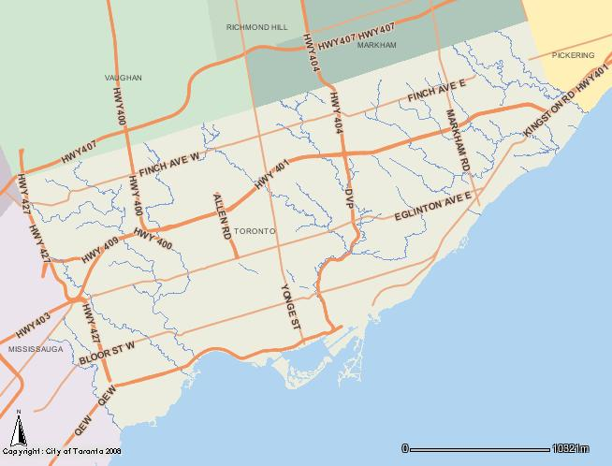
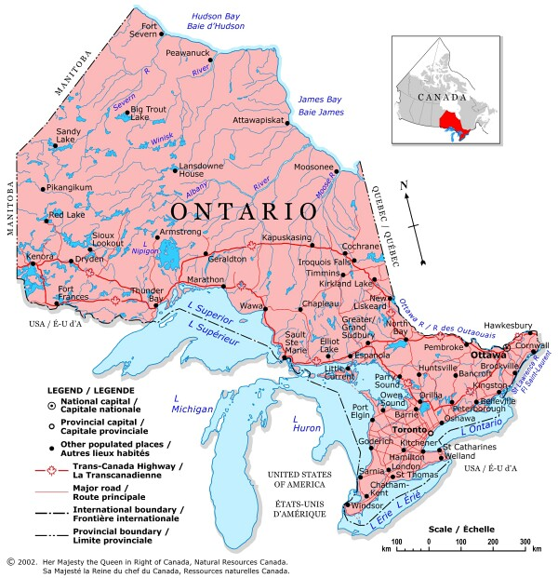
45 LIPs throughout Ontario
15 LIPs in Toronto (including Toronto–wide LIP) and 30 community-wide LIPs in the rest of Ontario
Notes:
There are now 15 LIPs in Toronto (inc. the Toronto city-wide LIP), and 30 community-wide LIPs in the rest of Ontario.
10

Slide 11
Stages in the LIPs Process
5. Report on the implementation and execution of the action plan annually
4. Develop an annual action plan to address local priorities
3. Conduct research and establish a comprehensive strategic plan to be implemented over three years
2. Create terms of reference for the partnership council
1. Establish a partnership council
Notes:
11

Slide 12
Opportunities the LIPs Present
Engage all levels of government in a partnership to achieve more comprehensive planning on immigration and settlement
Improve focus: Stakeholders and partners work toward common goals
Broaden responsibility and accountability for achieving collective outcomes
Induce municipalities and communities to play a larger role in planning for and guiding immigration and settlement
Utilize the tremendous amount of tacit knowledge and expertise available at the local level to enhance planning and to arrive at solutions attuned to local needs and capacities

Slide 13
Expand the breadth of stakeholders: municipal and/or regional government, settlement agencies, universal service providers, ethnocultural organizations, local associations, school boards, hospitals, police departments, seniors services, language instruction providers, employment networks, health associations, legal services …
Improve community consultation and buy-in: Involvement of immigrants and members of the host community in identifying needs, gaps, and strengths of the community, as well as possible solutions
Facilitate the sharing of knowledge and information

Slide 14
Challenges the LIPS Face
Information sharing capacity: process for sharing information across the LIPs and for transferring promising practices
Research capacity: baseline measures, needs and gaps assessment, outcome measurement
Efficiency: process for avoiding duplication of effort across LIPs
Addressing cross-cutting issues that affect all LIPs

Slide 15
Welcoming Communities Initiative
A multidisciplinary alliance of universities, colleges and communities aimed at developing and testing measures to attract and fully integrate immigrants and minorities in cities across Ontario
Base funding from a Community-University Research Alliance Grant from the Social Sciences and Humanities Research Council of Canada
Focuses on research that combines local expertise with academic scholarship in order to address practical concerns and challenges
Aim is to work with stakeholders to identify strategic priorities, conduct analyses, and shape policy guidance and practical advice

Slide 16
Important Features
Collaborative arrangement with Local Immigration Partnership Councils: designed to optimize efficiencies and effectiveness
Provide advice on LIPs at program level to CIC: cross-cutting issues

Slide 17
Research Strategies
Comparative studies
Multidisciplinary, multi-method
Iterative process with continual refinement as new knowledge and questions are generated by the research process and by new interests and events
Scholarship of engagement
Share findings and recommendations widely

Slide 18
Focus on promising practices and strategies for conducting evidence-based programming
Research to assess the impact of interventions and to determine whether the factors that make them effective can be replicated in other locations (are the factors and practices transferable)

Slide 19
Community
Assessment
Research
Research
Evaluation
Welcoming Communities
Goal Setting
Research
Research
Implementation

Slide 20
Recent and Current Projects
City Profiles, and Inventories and Audits of Local Resources, Services, and Structures
Making Ontario Home - Newcomer Settlement Services Needs and Use (OCASI and MCI)
Newcomer Settlement Information Testing, e.g., Welcome to Canada (CIC, Integration Branch)
Opinion Leader Interviews: Views on Cultural Diversity and Immigration (CIC, Ontario Region)

Slide 21
Promising and Innovative Practices (CISSA – ACSEI)
Characteristics of a Welcoming Community (CIC, Integration Branch)
Tools to Assess Indicators of a Welcoming Community (CIC, Ontario Region)
Antiracism and Antidiscrimination Observatory (CIC, Ontario Region)

Slide 22
Organizational Best Practices for the Local Immigration Partnership Councils (CIC, Ontario Region)
Sectoral Best Practices and Cross-Sectoral Best Practices for the Local Immigration Partnership Councils (CIC, Ontario Region)
Assessment and Learning-Dissemination Tool for the Local Immigration Partnerships (CIC, Ontario Region)
New Communication Tools to Disseminate Information on Promising Practices

Slide 23
Partnership Grant Proposal
Expansion of the Welcoming Communities Initiative to other provinces to provide support to communities and to place-based community-led initiatives focusing on making communities more receptive and able to serve the needs of newcomers
Particular focus on smaller centres and on practical research that meets the needs of communities
Letter of Intent to the Social Sciences and Humanities Research Council of Canada for this purpose was successful
Now engaged in development of full proposal: looking to strengthen our partnership through addition of new partners and discussion of community needs

Slide 24

For Further Information:
www.welcomingcommunities.ca

Slide 25
3 Key Questions
1. What would be the main challenges to organizing a community-led initiative like the LIPs in your community?
2. Do you think you would benefit from organizing a community collaboration like the LIPs? If yes, how might you go about initiating such a strategy?
3. What are the greatest needs in your community? How might a community collaboration like the LIPs address such needs?

