Slide 1
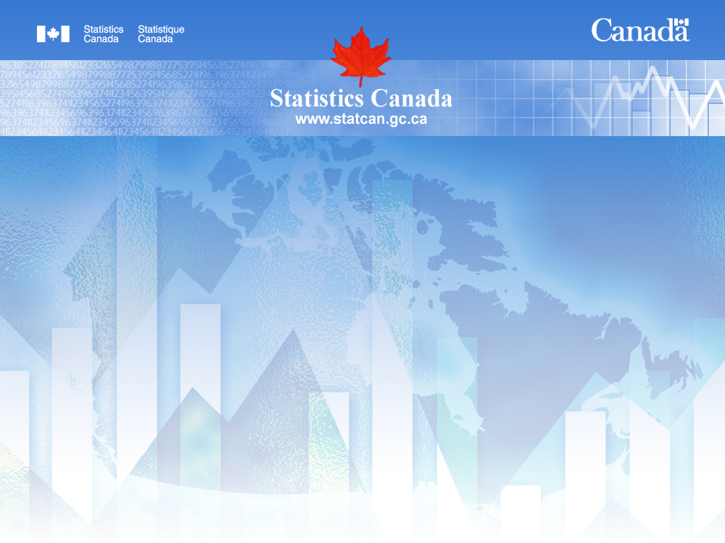
How many Canadians live in a city?
Conceptualization, definition and
proposed dissemination for alternative standards
Presentation to the
2011 International Methodology Symposium:
Strategies of Standardization of Methods and Tools
Ottawa, November 2 - 4, 2011
Ray D. Bollman, Rural Research Group, Statistics Canada
Peter Murphy, Geography Division, Statistics Canada

Slide 2
How many Canadians live in a city?
Outline
Introduction
2. Three ways of describing a city
  Form or Morphology – Population Centres
    Level of urbanization
    Rate of urbanization
  Administrative units – Census Subdivisions
    Level of urbanization
    Rate of urbanization
  Functional areas – CMAs and CAs
    Level of urbanization
    Rate of urbanization
3. How many Canadians live in a “city”?

Slide 3
How many Canadians live in a city?
1. Introduction
Data users ask Statistics Canada:
  How many Canadians live in cities?
Statistics Canada does not publish levels and rates of urbanization for:
      alternative definitions of a “city”
      alternative size cut-offs to be a “city
Our objective is to describe and document the levels and rates of urbanization for:
      alternative definitions of a “city”
      alternative size cut-offs to be a “city

Slide 4
How many Canadians live in a city?
Outline
Introduction
2. Three ways of describing a city
  Form or Morphology – Population Centres
    Level of urbanization
    Rate of urbanization

Slide 5
How many Canadians live in a city?
Outline
Introduction
2. Three ways of describing a city
  Form or Morphology – Population Centres
This is the “built-up area” of a settlement. It corresponds to the windshield view when you leave the settled area and drive into the unsettled or countryside area.
Arguably, this is the target clientele for an urban transportation planner.
Within Statistics Canada, built-up areas are population centres with a population density of 400 inhabitants per km² or more and with a total population of 1,000 more) (formerly known as “census urban” areas).
Following: Puderer, Henry A. (2009) Urban Perspectives and Measurement (Ottawa: Statistics Canada, Geography Working Paper, Catalogue no. 92F0138M — No. 2009001).

Slide 6
How many Canadians live in a city?

Slide 7
How many Canadians live in a city?
Outline
Introduction
2. Three ways of describing a city
  Form or Morphology – Population Centres
    Level of urbanization
    Rate of urbanization

Slide 8
How many Canadians live in a city?
Q: Where do people prefer to live?
Most of the change will be due to net migration (“voting with one’s feet”)
Q: What is the change
DUE TO RECLASSIFICATION in the number of people living in a certain urbanization size class of population centre?
Q: What is the TOTAL change in
the number of people living in a certain urbanization size class
of population centre?

Slide 9
How many Canadians live in a city?

Slide 10
How many Canadians live in a city?

Slide 11
How many Canadians live in a city?

Slide 12
How many Canadians live in a city?

Slide 13
How many Canadians live in a city?

Slide 14
How many Canadians live in a city?
Census rural was the geographic group with the second fastest population growth, 1991 to 1996

Slide 15
How many Canadians live in a city?

Slide 16
How many Canadians live in a city?

Slide 17
How many Canadians live in a city?
  Summary
Varying rates of population growth across size classes of population centres (within fixed boundaries -- due to demographic factors: births, deaths, net migration).
The biggest population centres do not always grow the fastest in terms of demographic factors.
However, the total change in the population living in a given population centre size class is also determined by re-classification.
Re-classification might be due:
  to demographic change causing the locality to go above the lower limit; or
  to go below the lower limit; or
  two population centres may be merged which may cause the population of the new population centre to be re-classified to another size class.
  Thus, between “t” and “t+1”, there is a change in the number of localities and a change in the number of Canadians enjoying the benefits and costs of a living in a locality of a given size.

Slide 18
How many Canadians live in a city?
Outline
Introduction
2. Three ways of describing a city
  Form or Morphology – Population Centres
    Level of urbanization
    Rate of urbanization
  Administrative units – Census Subdivisions

Slide 19
How many Canadians live in a city?
Outline
Introduction
2. Three ways of describing a city
  Form or Morphology – Population Centres
    Level of urbanization
    Rate of urbanization
  Administrative units – Census Subdivisions
This concept represents the view of the mayor.
How many people live in my incorporated city or town?
From the point of view of the resident – to whom do I pay my taxes and which administration is responsible for delivering local services.
On your Sunday afternoon drive, you usually cannot see the boundary of the administrative city – although there is often a sign at the boundary that says “Welcome to our city of X thousand residents.”

Slide 20
How many Canadians live in a city?
Outline
Introduction
2. Three ways of describing a city
  Form or Morphology – Population Centres
    Level of urbanization
    Rate of urbanization
  Administrative units – Census Subdivisions
Within Statistics Canada, a census subdivision is defined for each incorporated town or city and each incorporated municipality.

Slide 21
How many Canadians live in a city?
Outline
Introduction
2. Three ways of describing a city
  Form or Morphology – Population Centres
    Level of urbanization
    Rate of urbanization
  Administrative units – Census Subdivisions
    Level of urbanization

Slide 22
How many Canadians live in a city?

Slide 23
How many Canadians live in a city?
Outline
Introduction
2. Three ways of describing a city
  Form or Morphology – Population Centres
    Level of urbanization
    Rate of urbanization
  Administrative units – Census Subdivisions
    Level of urbanization
    Rate of urbanization

Slide 24
How many Canadians live in a city?
In general, from 1981 to 2006, CSDs of 250-499K reported the largest rate of demographic growth.
In general, from 1981 to 2006, smaller CSDs lost population due to demographic factors.

Slide 25
How many Canadians live in a city?

Slide 26
How many Canadians live in a city?

Slide 27
How many Canadians live in a city?

Slide 28
How many Canadians live in a city?

Slide 29
How many Canadians live in a city?

Slide 30
How many Canadians live in a city?

Slide 31
How many Canadians live in a city?

Slide 32
How many Canadians live in a city?

Slide 33
How many Canadians live in a city?

Slide 34
How many Canadians live in a city?

Slide 35
How many Canadians live in a city?
Summary
In general, larger CSDs have a larger demographic growth than smaller CSDs.
In the case of census subdivisions, most of the increased in urbanization is due to re-classification.

Slide 36
How many Canadians live in a city?
Outline
Introduction
2. Three ways of describing a city
  Form or Morphology – Population Centres
    Level of urbanization
    Rate of urbanization
  Administrative units – Census Subdivisions
    Level of urbanization
    Rate of urbanization
  Functional areas – CMAs and CAs

Slide 37
How many Canadians live in a city?
Outline
Introduction
2. Three ways of describing a city
  Form or Morphology – Population Centres
    Level of urbanization
    Rate of urbanization
  Administrative units – Census Subdivisions
    Level of urbanization
    Rate of urbanization
  Functional areas – CMAs and CAs
This concept is based on the idea that “We are all in this together.”
Thus, from the point of view of citizens and from the point of view of investors, we all share in the outcomes of good development projects and we all share in the outcomes of bad development projects.
In this sense, the agglomerated population operates together as a functional area, regardless of form and regardless of administrative boundaries.

Slide 38
How many Canadians live in a city?
Outline
Introduction
2. Three ways of describing a city
  Form or Morphology – Population Centres
    Level of urbanization
    Rate of urbanization
  Administrative units – Census Subdivisions
    Level of urbanization
    Rate of urbanization
  Functional areas – CMAs and CAs
Within Statistics Canada, Census Metropolitan Areas (CMAs) and Census Agglomerations (CAs) are delineated for any built-up core of 10,000 or more and includes all neighbouring census subdivisions where 50% or more of the employed residents commute to the built-up core.
Thus, commuting rates are used to measure or proxy the areas around the built-up core that “function together.”

Slide 39
How many Canadians live in a city?
Outline
Introduction
2. Three ways of describing a city
  Form or Morphology – Population Centres
    Level of urbanization
    Rate of urbanization
  Administrative units – Census Subdivisions
    Level of urbanization
    Rate of urbanization
  Functional areas – CMAs and CAs
    Level of urbanization

Slide 40
How many Canadians live in a city?

Slide 41
How many Canadians live in a city?
Outline
Introduction
2. Three ways of describing a city
  Form or Morphology – Population Centres
    Level of urbanization
    Rate of urbanization
  Administrative units – Census Subdivisions
    Level of urbanization
    Rate of urbanization
  Functional areas – CMAs and CAs
    Level of urbanization
    Rate of urbanization

Slide 42
How many Canadians live in a city?

Slide 43
How many Canadians live in a city?

Slide 44
How many Canadians live in a city?

Slide 45
How many Canadians live in a city?

Slide 46
How many Canadians live in a city?

Slide 47
How many Canadians live in a city?

Slide 48
How many Canadians live in a city?

Slide 49
How many Canadians live in a city?

Slide 50
How many Canadians live in a city?

Slide 51
How many Canadians live in a city?

Slide 52
How many Canadians live in a city?

Slide 53
How many Canadians live in a city?

Slide 54
How many Canadians live in a city?

Slide 55
How many Canadians live in a city?

Slide 56
How many Canadians live in a city?

Slide 57
How many Canadians live in a city?

Slide 58
How many Canadians live in a city?

Slide 59
How many Canadians live in a city?
Summary
In general, larger functional areas have a larger demographic growth than smaller functional areas.
In the case of functional areas, most (½ to ¾) of the increased in urbanization is due to demographic growth.

Slide 60
How many Canadians live in a city?
Outline
Introduction
2. Three ways of describing a city
  Form or Morphology – Population Centres
    Level of urbanization
    Rate of urbanization
  Administrative units – Census Subdivisions
    Level of urbanization
    Rate of urbanization
  Functional areas – CMAs and CAs
    Level of urbanization
    Rate of urbanization
3. So

Slide 61
How many Canadians live in a city?
To summarize the situation, we will concentrate on the 100,000 and over size class because:
  Mendelson and Lefebvre (2003) have shown that localities with a total population of 100,000 or more have most of the “functions” expected of a metropolitan centre
    Mendelson, Robert and Janet Lefebvre. (2003) Reviewing Census Metropolitan Areas (CMA) and Census Agglomerations (CA) in Canada According to Metropolitan Functionality (Ottawa: Statistics Canada, Geography Working Paper Series No. 2003-001, Catalogue no. 92F0138MIE)
However, the charts above have shown various city size classes so that you can choose:
  your preferred definition of a “city”;
  your preferred size cut-off to be a “city”

Slide 62
Understanding the “rural” in Rural Canada
How many Canadians live in a city?

Slide 63
Understanding the “rural” in Rural Canada
How many Canadians live in a city?

Slide 64
Understanding the “rural” in Rural Canada
How many Canadians live in a city?

Slide 65
Understanding the “rural” in Rural Canada
How many Canadians live in a city?

Slide 66
How many Canadians live in a city?
Outline
1. Introduction
2. Three ways of describing a city
  Form or Morphology – Population Centres
    Level of urbanization
    Rate of urbanization
  Administrative units – Census Subdivisions
    Level of urbanization
    Rate of urbanization
  Functional areas – CMAs and CAs
    Level of urbanization
    Rate of urbanization
3. How many Canadians live in a city?
If you define a “city” as having 100,000+ inhabitants, the answer is (in 2006):
  59% in population centres 100,000+ ;
  52% in census subdivisions of 100,000+ ; and
  68% in CMAs of 100,000+ .
The answer depends upon to whom you are talking:
  59% if you are talking to public transit planners;
  52% if you are talking to mayors; and
  68% if you are talking to economic development analysts.

Slide 67
How many Canadians live in a city?

Slide 68
How many Canadians live in a city?
Outline
Introduction
2. Three ways of describing a city
  Form or Morphology – Population Centres
    Level of urbanization
    Rate of urbanization
  Administrative units – Census Subdivisions
    Level of urbanization
    Rate of urbanization
  Functional areas – CMAs and CAs
    Level of urbanization
    Rate of urbanization
3. How many Canadians live in a “city”?
4. Summary

Slide 69
How many Canadians live in a city?
Summary
Which definition shows a higher level of urbanization?
    Functional areas (CMAs & CAs)
    Population centres (built-up areas)
    Census subdivisions (incorporated towns and cities)
What definition shows a higher rate of urbanization?
  (i.e. a higher change in the level of urbanization)
    Census subdivisions (due to amalgamation);
    Population centres & functional areas

Slide 70
How many Canadians live in a city?
Outline
Introduction
2. Three ways of describing a city
  Form or Morphology – Population Centres
    Level of urbanization
    Rate of urbanization
  Administrative units – Census Subdivisions
    Level of urbanization
    Rate of urbanization
  Functional areas – CMAs and CAs
    Level of urbanization
    Rate of urbanization
3. Summary – Questions and Discussion

